Slide 1
LED-DL Device Roadmaps
Jul. 2025

Slide 2
Table of Contents
1
2
3
4
5
6
Local Dimming Backlight Driver
Global Dimming Backlight Driver
LCD Bias
Mini-Micro LED Driver
Illumination LED Driver
RGB LED Driver

Slide 3

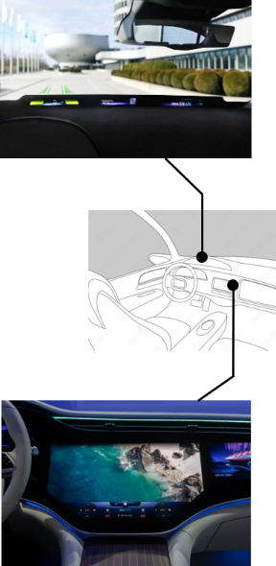

Local Dimming Automotive Backlight
Development
FuSa
RTM time
Released
Augmented
Sampling
Definition
Sample Time
Connectivity
TLC6C5748 - Q1
Zeppelin
TLC69699 - Q1
Dec’25
FuSa
SPI-CSI* protocol conversion
UART-CSI* protocol conversion
Dimming Zone Fault Summary
Direct drive
HTSSOP
SPI
SOT / WSON
Zeppelin+
TLP69697/8 - Q1
48 CS (32mA, 11V)
16-bit PWM Resolution
7-bit Dot Correction
LOD/LSD/TSD
SPI-CCSI* protocol conversion
CRC & Missing Clock Check
SOT
TLC696x1 - Q1
Direct drive
HTSSOP / QFN
CCSI
Dec’25
Dec’26
FuSa
FuSa
Mista
TLC6964x - Q1
Jojo
TLC6962x/3x – Q1
TLC696x2 - Q1
TLC6C5724 - Q1
FET controller
Up to 2 scans
Direct drive
HTSSOP / QFN
SPI / CSI
Time-multiplexing
HTSSOP / QFN
SPI / CSI
Direct drive
HTSSOP
SPI
TLC696x4 - Q1
48/24/8 CS (100/60mA, 16V)
Ultra low headroom voltage
16-bit PWM Resolution
7-bit Dot Correction
AHVC*
Insta-Boost*
LOD/LSD/TSD/Pin diagnostic
CRC/Communication loss
48 CS (100mA, 16V) x 4/8
Internal 50mΩ scan FET
Ultra low headroom voltage
16-bit PWM Resolution
7-bit Dot Correction
AHVC*
Insta-Boost*
Intelligent De-ghosting+
LOD/LSD/TSD/ Pin diagnostic
CRC/Communication loss
Stacked mode (Patented)
24 CS (50mA, 8V)
12-bit PWM Resolution
7-bit Dot Correction
LOD/LSD/TSD
TLC696x0 - Q1
Up to 4 scans
TLC696x8 - Q1
Up to 8 scans
Time-multiplexing
HTSSOP / QFN
CCSI
16 CS (30mA/60mA, 20V/50V)
15-bit PWM Resolution
AHVC*
Intelligent De-ghosting
LOD/LSD/TSD
AHVC*: Adaptive Headroom Voltage Control
CSI*: Cascaded Serial Interface
Insta-Boost*: Boost mode optimization
CCSI*: Continuous Clock Serial Interface

Slide 4
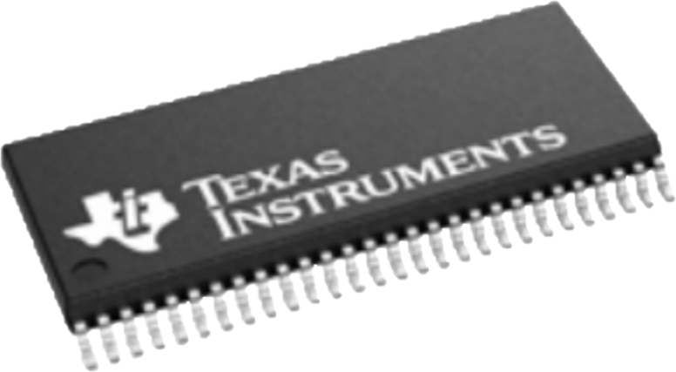
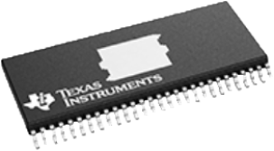
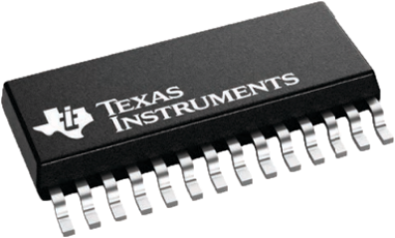
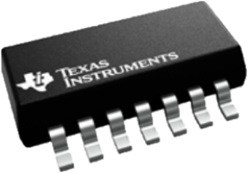
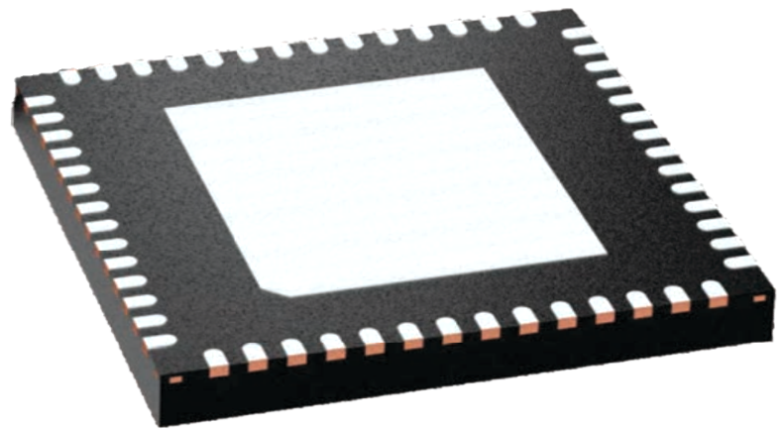
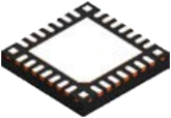
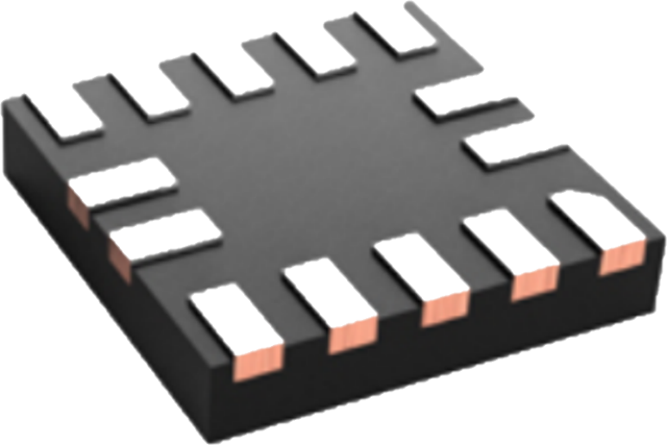
Jojo Family | Local Dimming LED Driver
Part Number | TLC69639-Q1 TLC69629-Q1 TLC69638-Q1 TLC69628-Q1 TLC69637-Q1 TLC69627-Q1 | TLC69636-Q1 TLC69626-Q1 TLC69635-Q1 TLC69625-Q1 TLC69634-Q1 TLC69624-Q1 | TLC69633-Q1 TLC69623-Q1 TLC69632-Q1 TLC69622-Q1 TLC69631-Q1 TLC69621-Q1
Channel | 48-CH, 100mA / 60mA | 24-CH, 100mA / 60mA | 8-CH, 100mA / 60mA
Package | 1. HTSSOP-56 -Thermal PAD options: Bottom / Top 2. QFN-56 -W*L*H: 8*8*1 mm | 1. HTSSOP-32 2. QFN-32 -W*L*H: 4*4*0.8 mm | 1. SOT-16 2. QFN-16 -W*L*H: 2.5*2.5*0.4 mm
FuSa Augmented (ISO26262, ASIL-B)
Programmable Safety Zone | Automatic Faults Summarizing
LED Drivers Cascaded Daisy Chain Connection
FuSa Compliant (ISO26262, ASIL-B)
Fail-safe Mode | OTP CRC | Memory CRC
Oscillator Watchdog | Communication watchdog
FuSa Capable
LED: LOD | LSD | Health check
Channel: APS | Health check
Device: UVLO | TSD | ISET out of range
Communication: CRC

Slide 5
Mista Family | Local Dimming LED Driver
Part Number | TLC69649-Q1 TLC69649S-Q1 TLC69648-Q1 TLC69648S-Q1 TLC69647-Q1 TLC69647S-Q1 | TLC69646-Q1 TLC69646S-Q1 TLC69645-Q1 TLC69645S-Q1 TLC69644-Q1 TLC69644S-Q1
Channel | 4 × 48-CH, 8 × 48-CH (Stacked mode) | 4 × 24-CH, 8 × 24-CH (Stacked mode)
Package | 1. HTSSOP-64 -Thermal PAD options: Bottom / Top 2. QFN-64 -W*L*H: 8*8*1 mm | 1. HTSSOP-40 2. QFN-40 -W*L*H: 4*4*0.8 mm
FuSa Augmented (ISO26262, ASIL-B)
Programmable Safety Zone | Automatic Faults Summarizing
LED Drivers Cascaded Daisy Chain Connection
FuSa Compliant (ISO26262, ASIL-B)
Fail-safe Mode | OTP CRC | Memory CRC
Oscillator Watchdog | Communication watchdog
FuSa Capable
LED: LOD | LSD | Health check
Scan FET: STG | STP
Channel: APS | Health check
Device: UVLO | TSD | ISET out of range
Communication: CRC

Slide 6


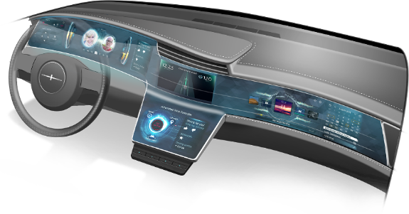
Linglong Family | Local Dimming LED Driver
Zone num.
16 Dimming zones (16 CH Direct)
Scan MOSFET controller
32 / 64 / 128 Dimming zones (2/4/8 Time-multiplexing)
Channel
30mA / 20V
60mA / 20V
30mA / 50V
60mA / 50V
30mA / 20V
60mA / 20V
30mA / 50V
60mA / 50V
30mA / 20V
60mA / 20V
30mA / 50V
60mA / 50V
Resolution
Up to 15-bit PWM / Hybrid Dimming
Up to 8 scan line
Up to 15-bit PWM / Hybrid Dimming
Function
20MHz CCSI
LED open / short
Adaptive FB
20MHz CCSI
MOSFET control
De-ghosting
20MHz CCSI
LED open / short
Adaptive FB
Package
QFN
HTSSOP
QFN
HTSSOP
QFN
HTSSOP
TLC696x1-Q1
TLC696x0-Q1
TLC696x2/4/8-Q1
TLC69601-Q1
TLC69611-Q1
TLC69651-Q1
TLC69661-Q1
TLC69600-Q1
TLC69610-Q1
TLC69650-Q1
TLC69660-Q1
TLC69602/4/8-Q1
TLC69612/4/8-Q1
TLC69652/4/8-Q1
TLC69662/4/8-Q1

Slide 7
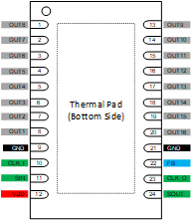
TLC696x1-Q1 16 CH Direct Local Dimming Driver
Features
Benefits
Power Supply Vcc Voltage Range: 3V to 5.5V
20MHz Two-Wire Interface:
4K zone supported in 240Hz frame rate
1.8V/3.3V bus voltage compatible
Up to 20KHz dimming frequency
Flexible Dimming:
Up to 15-bit brightness resolution
Support 8-step option hybrid dimming
Current Sink:
Max. 30mA / 60mA OUT pin current in 8-bit options
Up to 20V / 50V OUT pin voltage
2% (typ) channel mismatch, 2% (typ) device mismatch
Digital:
Independent update for zero frame latency
Support Variable Refresh Rate (VRR)
No external Components needed
Adaptive FB directly controls DC/DC
Support LED open / short protection
WCSP (2.4 mm * 1.6 mm , 0.4 mm pitch)
QFN-24 (4 mm * 4 mm, 0.5 mm pitch) for AUTO
HVSSOP-24 (6 mm * 6.1 mm, 0.5 mm pitch) for AUTO
Two-wire design enables easy PCB routing and better EMC
Adaptive headroom voltage enable high system efficiency
High resolution supports high dynamic range
High PWM frequency allows high refresh rate
Applications
Notebook / Tablet Local Dimming LED Driver
Monitor Local Dimming LED Driver
Automotive Local Dimming LED Driver

Slide 8
TLC696x2/4/8-Q1 Time-multiplexing Local Dimming Driver
Features
Benefits
Power Supply Vcc Voltage Range: 3V to 5.5V
20MHz Two-Wire Interface:
4K zone supported in 240Hz frame rate
1.8V/3.3V bus voltage compatible
Up to 20KHz dimming frequency
Flexible Dimming:
Up to 15-bit brightness resolution
Support 8-step option hybrid dimming
Current Sink:
Max. 30mA / 60mA OUT pin current in 8-bit options
Up to 20V / 50V OUT pin voltage
2% (typ) channel mismatch, 2% (typ) device mismatch
Digital:
Support 32/64/128 dimming zones
Independent update for zero frame latency
Support Variable Refresh Rate (VRR)
No external Components needed
Adaptive FB directly controls DC/DC
Support LED open / short protection
WCSP (2.4 mm * 1.6 mm , 0.4 mm pitch)
QFN-24 (4 mm * 4 mm, 0.5 mm pitch) for AUTO
HVSSOP-24 (6 mm * 6.1 mm, 0.5 mm pitch) for AUTO
Two-wire design enables easy PCB routing and better EMC
Adaptive headroom voltage enable high system efficiency
High resolution supports high dynamic range
High PWM frequency allows high refresh rate
Applications
Notebook / Tablet Local Dimming LED Driver
Monitor Local Dimming LED Driver
Automotive Local Dimming LED Driver

Slide 9
TLC696x0-Q1 Scan MOSFET Controller
Features
Benefits
Power Supply Vcc Voltage Range: 3V to 5.5V
Support up to 8 Ext. scan MOSFET supported
20MHz Two-Wire Interface:
1.8V/3.3V Bus Voltage Compatible
Compatible with TLC696x2/4/8
Programable 6-bit line switch time
Max. 30mA / 60mA driving current
Up to 20V / 50V OUT pin voltage
Programable 7-bit individual MOSFET driving ability
Integrated upside de-ghosting
WCSP (2.4 mm * 1.6 mm , 0.4 mm pitch)
QFN-24 (4 mm * 4 mm, 0.5 mm pitch) for AUTO
HVSSOP-24 (6 mm * 6.1 mm, 0.5 mm pitch) for AUTO
One-bus design enables easy system routing
Flexible placed in serial devices
Flexible with scanning MOSTFET
Applications
Scan MOSFET controller for TLC696x2/4/8

Slide 10
TLC69699-Q1 Augmented Connectivity for TLC696xx-Q1
Features
Benefits
Developed according ISO26262
Documentation available to aid ISO 26262 system design up to ASIL B
Input voltage range: 2.5V to 5.5V
Diagnostics
SPI CRC error detection
SPI time out detection
CCSI brightness and register data CRC detection
Missing continuous clock detection
Oscillator fault detection
OTP CRC error detection
Fault pin report
Low EMI
Programmable output clock frequency
Programmable jitter on output clock
Data ready interrupt
Operating ambient temperature (-40°C to 125°C)
Package:
WSON-12 Wettable (3mm*3mm*0.8mm)
SOT-14 (4.2mm*2mm*1.1mm)
Compatible with SPI controller
Missing continuous clock detection
Brightness and register data integrity inspection
Known safe state for LED drivers when SPI communication is lost
Spread spectrum continuous clock for low EMI
Applications
SPI compatible connectivity for TLC696x0/1/2/4/8-Q1

Slide 11
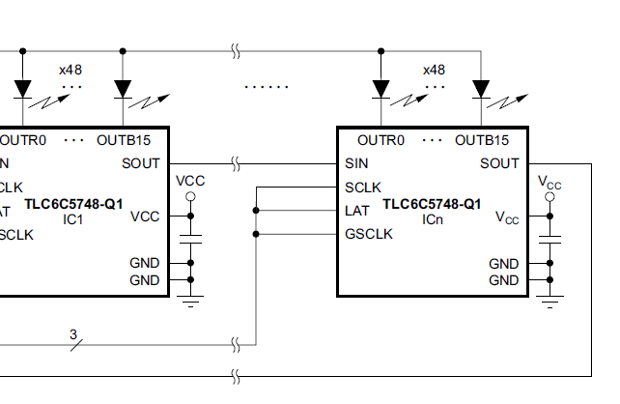
TLC6C5748-Q1
Features
Benefits
AEC-Q100 Qualified for Automotive Applications (Grade 1: T_{A} -40C to +125C)
48 Channel Outputs
Constant Current up to 31.9mA
Breakdown Voltage up to 11V
Constant Current and Dimming
3-bit Max Current
7-bit, Dot Correction for Each Channel
Configurable Grayscale Mode: 16-bit
Precise Constant Current Regulation
Channel-to-Channel: ± 2% (typ)
Device-to-Device: ± 2% (typ)
Diagnostic & Protection
LED Open/Short Detection
Output Short to GND Detection
Over Temperature Detection
Thermal Shutdown
Serial Data Interface
HTSSOP-56 Package (DCA) 6.1mm x 14mm
Best to drive 48 LED zones with uniformity
Perfect solution for chip-on-LED-board architecture
Direct daisy chain interface with TCON controller
Max 3 single-junction LEDs/ 1 dual-junction LED in series
Reduces system power consumption
Reduces system cost
Unlimited device cascading
Applications
Automotive Local Dimming Backlight
Automotive Pixel Lamp
Automotive RGB display

Slide 12
TLC6C5724-Q1
Features
Benefits
AEC-Q100 Qualified for Automotive Applications (Grade 1: T_{A} -40C to +125C)
24 Channel Outputs
Constant Current up to 50mA, Set via External Resistor
Breakdown Voltage up to 8V
Constant Current
7-bit, 128-step Dot Correction for Each Channel
8-bit, 256-step Brightness Control for Each Color Group
PWM Dimming
Configurable Grayscale Mode: 12-bit, 10-bit, 8-bit
Diagnostic & Protection
LED Open/Short Detection
Output Short to GND Detection
Adjacent-Pin Short Detection
Pre-Thermal Warning, Thermal Shutdown
IREF Resistor Open and Short Detection and Protection
GCLK Error Detection
LOD_LSD Circuit Self Test
Serial Data Interface
Programmable Output Slew Rate
Output Channel Group Delay
HTSSOP-38 Package (DAP) 8.1mm x 12.5mm
Constant current provide good LED brightness uniformity
Full LED diagnostics features improves system reliability and safety
Individual PWM dimming and DOT correction benefits RGB LED color mixing
Programmable slew rate control optimizes the system EMI performance
Output group delay reduce the peak load of front power stage
Applications
Automotive Cluster Indicators
Automotive HVAC Panel Backlighting
Automotive Local Dimming Display
Automotive Ambient Lighting

Slide 13
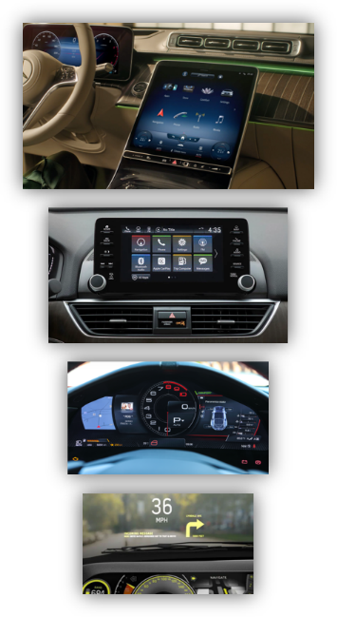

Global Dimming Automotive Backlight
Converter
Released
Development
Controller
Sampling
Definition
Power
LP8866(S)-Q1
LP8890/1/6/7-Q1
3V to 48V V_{IN}
6/4 ch x 150/200mA I_{LED}, 7.5A I_{SW}
Dimming Ratio 65,000:1
Power Line NFET Driver
Full Diagnostics
HTSSOP/QFN
I ²C
HTSSOP/QFN
I ²C
3V to 48V V_{IN}
6 ch x 200mA (S: 150mA) I_{LED}
Dimming Ratio 32,000:1
Power Line PFET Driver
Full Diagnostics
1A
LP8894/5-Q1
HTSSOP/QFN
Stand Alone
LP8864(S)-Q1
LP8870/1/2/3-Q1
HTSSOP/QFN
I ²C
3V to 48V V_{IN}
6 /4 ch x 150mA I_{LED}, 5.4A I_{SW}
Dimming Ratio 65,000:1
Power Line NFET Driver
Full Diagnostics
Dual Phase Operation
3V to 48V V_{IN}
4 ch x 200mA (S: 150mA) I_{LED}
Dimming Ratio 32,000:1
Power Line PFET Driver
Full Diagnostics
HTSSOP/QFN
I 2C
0.8A
LP8874/5-Q1
HTSSOP/QFN
Stand Alone
LP8867(C)/9(C)-Q1
LP8865(C)/8-Q1
LP8876/7-Q1
HTSSOP
Stand Alone
VSON
Stand Alone
QFN
I ²C
4.5V to 40V V_{IN}
4 / 3 ch x 120mA I_{LED}, 3.3A I_{SW}
Dimming Ratio 10,000:1
Power Line PFET Driver
Current Foldback w/ Ext. NTC
4.5V to 65V V_{IN}
1 ch x 4 / 2A I_{SW}
Dimming Ratio >32,000:1
Multi-topology
4.5V to 36V V_{IN}
4 / 6 ch x 150mA I_{LED}, 4.5A I_{SW}
Dimming Ratio 25,000:1
Power Line NFET Driver
Full Diagnostics
0.6A

Slide 14
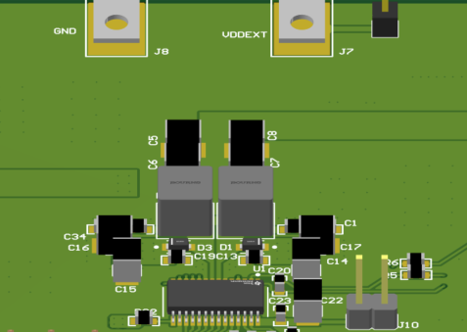
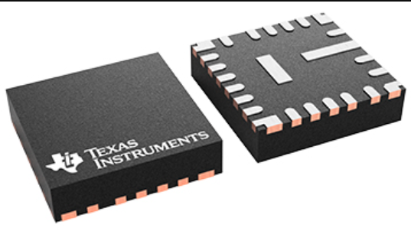
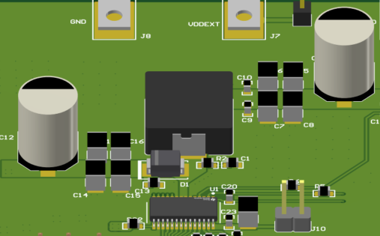
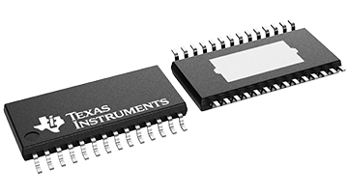
Camaro Family Overview
LP889x(D)-Q1 Isw = 7.5A
20W
Converter
LP887x(D)-Q1 Isw = 5.4A
Single Phase
Dual Phase
Single Phase
Dual Phase
150 mA/CH
LP8890-Q1 >> I²C, 6-CH
LP8891-Q1 >> I²C, 4-CH
LP8894-Q1 >> Standalone, 6-CH
LP8895-Q1 >> Standalone, 4-CH
200 mA/CH
LP8896-Q1 >> I2C, 6-CH
LP8897-Q1 >> I2C, 4-CH
150 mA/CH
LP8890D-Q1 >> I²C, 6-CH
LP8891D-Q1 >> I²C, 4-CH
LP8894D-Q1 >> Standalone, 6-CH
LP8895D-Q1 >> Standalone, 4-CH
200 mA/CH
LP8896D-Q1 >> I2C, 6-CH
LP8897D-Q1 >> I2C, 4-CH
150 mA/CH
LP8870/2-Q1 >> I²C, 6-CH
LP8871/3-Q1 >> I²C, 4-CH
LP8874-Q1 >> Standalone, 6-CH
LP8875-Q1 >> Standalone, 4-CH
150 mA/CH
LP8870D-Q1 >> I²C, 6-CH
LP8871D-Q1 >> I²C, 4-CH
LP8874D-Q1 >> Standalone, 6-CH
LP8875D-Q1 >> Standalone, 4-CH
Performance
Leader
Dual Phase Operation
Package Availability
Diagnostics & Protections
Dual
Phase
HotRod QFN-24
4 x 4 mm
θ_{JA} = 27.6 °C/W
NMOS Power line FET
I2C with CRC
$0.4 BOM cost saving
40% smaller, 70% thinner
EMI compliant without CMC
Stackable for 8-12CH display
HTSSOP-28
9.7 x 4.4 mm
θ_{JA} = 26 °C/W
Dimming Ratio
Single
Phase
Up to 65,000:1 with PWM dimming
Up to 520,000:1 with hybrid dimming

Slide 15
Camaro LP887x-Q1 Family 4/6 CH
Development
Next-gen 4 / 6-ch x 150 mA Automotive LED Backlight Driver with Ultra-low EMI
Features
Applications
AEC-Q100 Qualified for Automotive Applications (Grade 1: T_{A} -40C to +125C)
Boost or Sepic converter with Integrated Power MOSFET
Input Voltage Operating Range 3 V to 48 V
Up to 45 V Output Voltage
5.4 A Switching Current Limit
Dynamic switching current limit for cold crank
Switching Frequency 100 kHz to 2.2 MHz with the option of sync input
Support Dual/Single phase operation
Output voltage automatically discharged when boost is disabled
Thermal
50 mΩ low rds on of SW FET
VQFN-24(W) HotRod /PWP- 28 Package available
Adaptive Voltage Control for Power Optimization
Low EMI/noise
DRSS for ultra-low EMI
Optimized switching slew rate
High-Precision Current Sinks
4/6 channels * 150 mA LED output total current
Current Matching 1%(typical), 2%@150mA, 3%@50mA
Up to 16-bit LED Dimming Resolution
Dimming Ratio 65,000:1 @ 152Hz PWM(100ns minimum pulse)
Support Direct PWM, enhanced Phase shift PWM, Hybrid dimming and Analog dimming mode with external PWM input pin
Full Protection and Diagnostic Features
Support Power Line NFET for input OCP protection
Soft Start Control for Vin transient
1MHz I2C interface with CRC
Open, Shorted, Short-to-GND LED Fault Detection
Boost Output OVP and OCP, Input UVLO, OVP and OCP
External Resistor Fault Errors
Support Thermal warning and thermal shutdown
Automotive Infotainment
Automotive Instrument Clusters
Smart Mirrors
Heads-Up Displays (HUD)
Central Information Displays (CID)
Audio-Video Navigation (AVN)

Slide 16
Camaro LP889x-Q1 Family 4/6 CH
Development
Next-gen 4 / 6-ch x 150/200 mA Automotive LED Backlight Driver with Ultra-low EMI
Features
Applications
AEC-Q100 Qualified for Automotive Applications (Grade 1: T_{A} -40C to +125C)
Boost or Sepic converter with Integrated Power MOSFET
Input Voltage Operating Range 3 V to 48 V
Up to 45 V Output Voltage
7.5 A Switching Current Limit
Dynamic switching current limit for cold crank
Switching Frequency 100 kHz to 2.2 MHz with the option of sync input
Support Dual/Single phase operation
Output voltage automatically discharged when boost is disabled
Thermal
50 mΩ low rds on of SW FET
VQFN-24(W) HotRod /PWP- 28 Package available
Adaptive Voltage Control for Power Optimization
Low EMI/noise
DRSS for ultra-low EMI
Optimized switching slew rate
High-Precision Current Sinks
4/6 channels * 150/200 mA LED output total current
Current Matching 1%(typical), 2%@150mA, 3%@50mA
Up to 16-bit LED Dimming Resolution
Dimming Ratio 65,000:1 @ 152Hz PWM(100ns minimum pulse)
Support Direct PWM, enhanced Phase shift PWM, Hybrid dimming and Analog dimming mode with external PWM input pin
Full Protection and Diagnostic Features
Support Power Line NFET for input OCP protection
Soft Start Control for Vin transient
1MHz I2C interface with CRC
Open, Shorted, Short-to-GND LED Fault Detection
Boost Output OVP and OCP, Input UVLO, OVP and OCP
External Resistor Fault Errors
Support Thermal warning and thermal shutdown
Automotive Infotainment
Automotive Instrument Clusters
Smart Mirrors
Heads-Up Displays (HUD)
Central Information Displays (CID)
Audio-Video Navigation (AVN)
LP889x-Q1

Slide 17
LP8867- Q1 / LP8869 - Q1
Features
Benefits
AEC-Q100 Qualified for Automotive Applications (Grade 1: T_{A} -40C to +125C)
4/3 x 120mA LED Driver for Automotive LCD Display
High Dimming Ratio of 10 000:1 at 100 Hz
Current Matching 1% (Typical)
LED String Current up to 120 mA per Channel
Outputs can be Combined Externally for Higher Current per String
Integrated Boost/SEPIC Converter for LED String Power
Integrated SW FET with Up to 3A Switching Current Limit
Input Voltage Operating Range 4.5 V to 40 V
Output Voltage up to 45 V
Switching Frequency 300 kHz to 2.2 MHz
Switching Synchronization Input
Spread Spectrum for Lower EMI
Minimum Number of External Components
Protection and Fault Detection
Power-Line FET Control for Battery Bus Protection
Fault Output
Input Voltage OVP, UVLO and OCP
Boost OVP, SW OVP
Open and Shorted LED Fault Detection
Automatic LED Current Reduction With External Temperature Sensor
Thermal Shutdown
HTSSOP-20 Package (PWP)
Minimum system cost and PCB size with Integrated MOSFET
Good EMI performance with Spread Spectrum function
Save MCU resource with
Power-Line FET control
Automatic LED current reduction with external Temperature Sensor
Applications
Backlight for:
Automotive Infotainment
Automotive Instrument Clusters
Smart Mirrors
Heads-Up Displays (HUD)
Central Information Displays (CID)
Audio-Video Navigation (AVN)

Slide 18
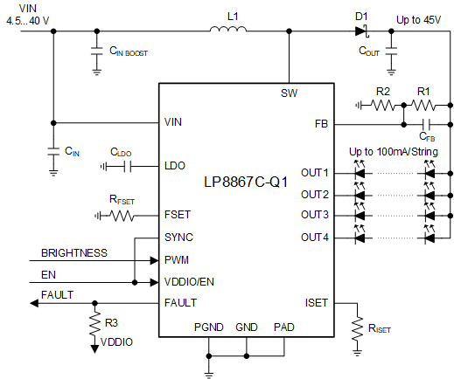
LP8867C- Q1 / LP8869C - Q1
Features
Benefits
AEC-Q100 Qualified for Automotive Applications (Grade 1: T_{A} -40C to +125C)
4/3 x 120mA LED Driver for Automotive LCD Display
High Dimming Ratio of 10 000:1 at 100 Hz
Current Matching 1% (Typical)
LED String Current up to 120 mA per Channel
Outputs can be Combined Externally for Higher Current per String
Integrated Boost/SEPIC Converter for LED String Power
Integrated SW FET with Up to 3A Switching Current Limit
Input Voltage Operating Range 4.5 V to 40 V
Output Voltage up to 45 V
Switching Frequency 300 kHz to 2.2 MHz
Switching Synchronization Input
Spread Spectrum for Lower EMI
Minimum Number of External Components
Protection and Fault Detection
Fault Output
Input Voltage OVP, UVLO and OCP
Boost OVP, SW OVP
Open and Shorted LED Fault Detection
Thermal Shutdown
HTSSOP-20 Package (PWP)
Minimum system cost and PCB size with Integrated MOSFET
Good EMI performance with Spread Spectrum function
Applications
Backlight for:
Automotive Infotainment
Automotive Instrument Clusters
Smart Mirrors
Heads-Up Displays (HUD)
Central Information Displays (CID)
Audio-Video Navigation (AVN)

Slide 19
LP8868/5-Q1
Features
Benefits
AEC-Q100 Qualified for Automotive Applications (Grade 1: T_{A} -40C to +125C)
Single Channel Current Sink
Output Current up to 4A / 2A
Analog, PWM, Hybrid Brightness Control Modes
Analog Dimming (128:1)
PWM Dimming (0.2us min. on time)
Hybrid Dimming (2000:1 in 20kHz PWM)
Boost/Buck-boost/Buck Power Stage Topology
Input Voltage Operating Range 4.5V to 65V
Integrated 150mΩ / 300mΩ NFET
NFET Current Limit: 4.5A / 2.5A
Switching Frequency 100 kHz to 2.2 MHz
Spread Spectrum for Lower EMI
Protection and Diagnostic Features
Cycle-by-cycle Current Limit
LED Open
Thermal Shutdown
Fault Output
VSON-14/HVSSOP-12 Package
High Brightness Support with
High Power Density Support Various Application
Dimming
Fast Response Support High Dimming Ratio Performance
Mixed Analog and PWM Dimming Method Accelerate the Dimming Performance
Buck/boost
Buck
Applications
Backlight for:
Automotive Infotainment
Automotive Instrument Clusters
Smart Mirrors
Heads-Up Displays (HUD)
Central Information Displays (CID)
Audio-Video Navigation (AVN)
Boost

Slide 20
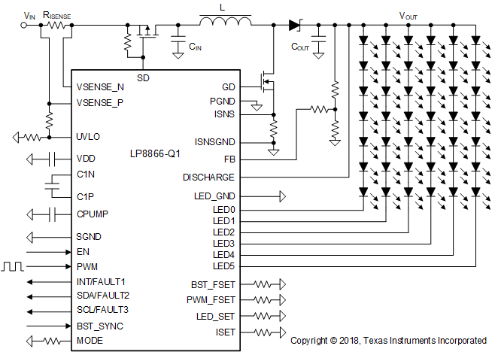
LP8866-Q1 / LP8866S-Q1
Features
Benefits
AEC-Q100 Qualified for Automotive Applications (Grade 1: T_{A} -40C to +125C)
Six High-Precision Current Sinks
Output Current up to 200/150 mA/Channel
Current Matching 1% (typical)
Up to 16-bit LED Dimming Resolution
Dimming Ratio 32,000:1 @ 152Hz PWM
I2C, PWM Brightness Control Modes
8 configurable LED strings configuration
Automatically adjusts phase shift for number of LED strings
Boost Controller for LED String Power
Input Voltage Operating Range 3 V to 48 V
Switching Frequency 100 kHz to 2.2 MHz
Boost SYNC input to set boost switching frequency from an external clock
Spread Spectrum for lower EMI
Adaptive Voltage Control for Power Optimization
Output voltage automatically discharged when boost is disabled
Full Protection and Diagnostic Features
Open, Shorted, Short-to-GND LED Fault Detection
Boost Output OVP and OCP
Boost Input UVLO, OVP and OCP
External Resistor Fault/Charge Pump Fault/CRC Errors
VDD UVLO and Thermal Shutdown
HTSSOP-38 Package (DCP)
High Brightness and Big Size LCD Panel Support with
6 * 200/150mA LED Output
Good Cold cranking behavior with
Input Voltage Operating Range 3 V to 48 V
Good EMI Performance with
Phase Shifted LED Outputs
Boost Converter Spread Spectrum
Hybrid Dimming (Linear + PWM)
Boost Synchronization Input
Ease Customer design with
Resistor Configuration for PWM /Boost Frequency/LED Configuration/Dimming Mode
Integrated Discharge Function
Applications
Backlight for:
Automotive Infotainment
Automotive Instrument Clusters
Smart Mirrors
Heads-Up Displays (HUD)
Central Information Displays (CID)
Audio-Video Navigation (AVN)

Slide 21
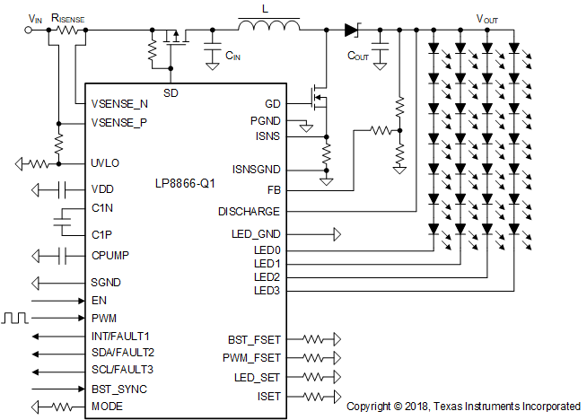
LP8864-Q1 / LP8864S-Q1
Features
Benefits
AEC-Q100 Qualified for Automotive Applications (Grade 1: T_{A} -40C to +125C)
Four High-Precision Current Sinks
Output Current up to 200/150 mA/Channel
Current Matching 1% (typical)
Up to 16-bit LED Dimming Resolution
Dimming Ratio 32,000:1 @ 152Hz PWM
I2C, PWM Brightness Control Modes
8 configurable LED strings configuration
Automatically adjusts phase shift for number of LED strings
Boost Controller for LED String Power
Input Voltage Operating Range 3 V to 48 V
Switching Frequency 100 kHz to 2.2 MHz
Boost SYNC input to set boost switching frequency from an external clock
Spread Spectrum for lower EMI
Adaptive Voltage Control for Power Optimization
Output voltage automatically discharged when boost is disabled
Full Protection and Diagnostic Features
Open, Shorted, Short-to-GND LED Fault Detection
Boost Output OVP and OCP
Boost Input UVLO, OVP and OCP
External Resistor Fault/Charge Pump Fault/CRC Errors
VDD UVLO and Thermal Shutdown
HTSSOP-38 Package (DCP)
High Brightness and Big Size LCD Panel Support with
4 * 200/150mA LED Output
Good Cold cranking behavior with
Input Voltage Operating Range 3 V to 48 V
Good EMI Performance with
Phase Shifted LED Outputs
Boost Converter Spread Spectrum
Hybrid Dimming (Linear + PWM)
Boost Synchronization Input
Ease Customer Design with
Resistor Configuration for PWM /Boost Frequency/LED Configuration/Dimming Mode
Integrated Discharge Function
Applications
Backlight for:
Automotive Infotainment
Automotive Instrument Clusters
Smart Mirrors
Heads-Up Displays (HUD)
Central Information Displays (CID)
Audio-Video Navigation (AVN)

Slide 22
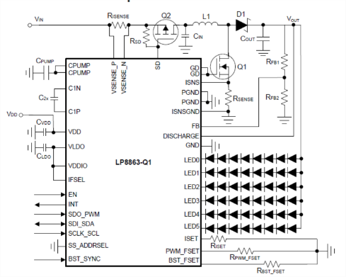
LP8863-Q1
Features
Benefits
AEC-Q100 Qualified for Automotive Applications (Grade 1: T_{A} -40C to +125C)
Six High-Precision Current Sinks
Output Current up to 150 mA/Channel
Current Matching 1% (typical)
Up to 16-bit LED Dimming Resolution
Individual LED String Brightness Control
Dimming Ratio 32,000:1 @ 152Hz PWM
Boost Controller for LED String Power
Input Voltage Operating Range 3 V to 48 V
Switching Frequency 300 kHz to 2.2 MHz
Boost SYNC input
Spread Spectrum for lower EMI
Adaptive Voltage Control for Power Optimization
Discharge function when boost is disabled
Extensive Protection Features
Open and Shorted LED Fault Detection
Boost Output OVP and OCP
Boost Input UVLO, OVP and OCP
VDD UVLO and Thermal Shutdown
Simple Configuration
Resistor configuration for Boost Frequency, LED PWM Frequency and LED Current
Automatic String Configuration Detection
Automatically adjusts phase shift for number of LED strings
I2C, SPI and PWM Brightness Control Modes
HTSSOP-38 Package (DCP)
High Brightness and Big Size LCD Panel Support with
6*150mA LED output
Good Cold cranking behavior with
Input Voltage Operating Range 3 V to 48 V
Good EMI Performance with
Phase Shifted LED Outputs
Boost Converter Spread Spectrum
Hybrid Dimming (Linear + PWM)
Boost Synchronization Input
Ease Customer Design with
Resistor Configuration
Automatic Detection of LED String Configuration
Integrated Discharge Function
Applications
Backlight for:
Automotive Infotainment, Instrument Clusters
Smart Mirrors, Heads-Up Displays (HUD)
Central Information Displays (CID)
Audio-Video Navigation (AVN)

Slide 23
Automotive LCD Bias Roadmap
Unipolar
Released
Development
Bipolar
TPS65150-Q1
Saber
TPS92100-Q1
4-CH
TSSOP
I ²C
5-CH
QFN
I ²C
AVDD, VCOM, VGH, VGL
Excellent AVDD output voltage accuracy: <1%
PAV_{DD}, NAV_{DD,} VGH, VGL, VCOM
8bits V_{COM} Calibrator with buffer
Supports power-up and -down sequencing
I²C interface with EEPROM
Peak Efficiency >90 % at V_{IN} = 3.3V
System Architecture
TPS65131-Q1
Saber
2-CH
QFN
I ²C
2-CH
QFN
I ²C
PAV_{DD}, NAV_{DD}
Independent enable pins for power up and down
Power save mode available at low load currents
Up to 85% efficiency
PAV_{DD}, NAV_{DD}
8bits V_{COM} Calibrator with buffer
Supports power-up and -down sequencing
I²C interface with EEPROM
Peak Efficiency >90 % at V_{IN} = 3.3V
Notes:
a-Si (amorphous Silicon) is one of the most widely used, simple technology and low cost. It's PPI about 200.
IPS (In-Plane Switching) is the best all around panel type, but is more expensive. It supports a wide visual angle and good performance of color reduction.
LTPS (Low Temperature Polysilicon) panels consume lower power and support high resolution (>500 ppi).

Slide 24

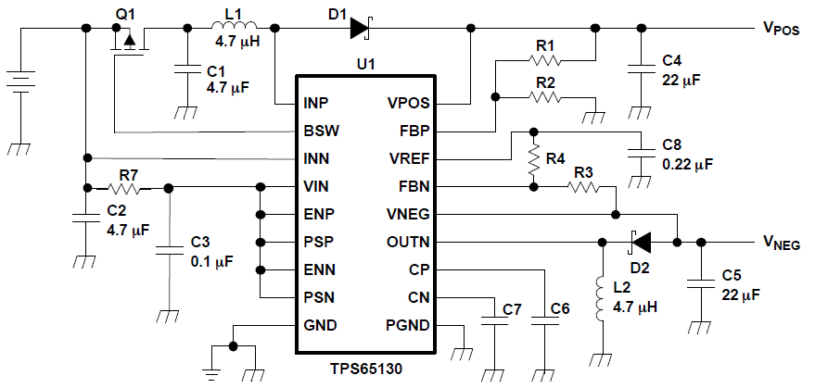

TPS65131-Q1
Dual Output Regulator
Input Voltage Range: 2.7 to 6V
3.3V, 5V inputs
VPOS Boost Converter (PAV_{DD}):
V_{POS}: ~VIN to 15V
1.4MHz Switching Frequency
1.7A Minimum Current Limit
Up to 89% Efficiency
VNEG Inverting B-B Converter (NAV_{DD})
V_{NEG}: ~15 to 2V
1.4MHz Switching Frequency
1.7A Minimum Current Limit
Up to 81% Efficiency
Power-Save Mode for High Efficiency at Low Load Currents
Independent Enable Inputs for Power-Up and Power-Down Sequencing
Pin-selectable, forced Fixed-Frequency PWM Operation
Overvoltage Protection on Both Outputs
Small 4-mm × 4-mm QFN-24 Package (RGE)
AEC-Q100 Grade 2 n40c to 85c operating temp
High efficient dual output device (total efficiency up to 85%)
High flexibility (independent enable pins…)
Low external component count for reduced overall BOM costs
Automotive qualified
bipolar (± AVDD)
TFT LCD Displays for Automotive
Infotainment, Cluster, Navigation
Rear Seat Entertainment

Slide 25
Auto Mini-Micro LED Driver Roadmap
Released
FuSa
Developing
FuSa
Developing
TLC69637-Q1
TLC69638-Q1
TLC69639-Q1
7-bit Dot Correction
16-bit PWM Resolution
17MHz SPI / CSI
Spread Spectrum
0.2V Vsat @30mA
UART/CAN over UPAC
TLC69697/8-Q1
Integrated SW FETs
7-bit Dot Correction
16-bit PWM Resolution
12MHz SPI / CSI
0.2V Vsat @30mA
UART/CAN over UPAC
TLC69697/8-Q1
Integrated SW FETs
8-bit Dot Correction
16-bit PWM Resolution
12MHz CSI
Stackable mode
UART/CAN over UPAC
TLC69697/8-Q1
TLC69648-Q1
LP5893-Q1
48ch
48ch x 4sw
48ch x 16sw
100 mA/ch
80 mA/ch
40 mA/ch
Higher Dot Current
Higher LED #
Sample
Released
Released
7-bit Dot Correction
16-bit PWM Resolution
12MHz SPI
0.35V Vsat @30mA
UART/CAN over UPAC
TLC69697-Q1
LP5860-Q1
LP5868-Q1
LP5866-Q1
Integrated SW FETs
8-bit Dot Correction
8/16-bit PWM Resolution
12MHz SPI
0.6V Vsat @75mA
UART/CAN over UPAC
LP5869-Q1
Integrated SW FETs
8-bit Dot Correction
16-bit PWM Resolution
50MHz CCSI
Stackable mode 2x/4x
SPI over UPAC
LP5899-Q1
TLC69620-Q1
LP5892-Q1
LP5891-Q1
48ch
18ch x 11sw
48ch x 16sw
80 mA/ch
80 mA/ch
20/40 mA/ch
LED# | About 200 | About 1,000 | About 10,000
I avg | 25mA | 10mA | 1mA
LED Pitch | 10mm | 2-5mm | 1mm
Notes:
The background is that a market called body exterior freeform interactive signal display appears. What’s that??
Traditional Lighting is a pure functional application, request on/off the LED or adjust the brightness.
FISD added value to more intelligent applications, offering personalization, communication, and assistance for the driver
This figure provides the overview of popular exterior FISD application to help understand. For example, the grille is designed to shows smooth animation as a unique character, display closed to the handle warn the status to communicate with passenger.
Though There are many applications, they can be classified to 3 parts by the pixel pitch. it is the distance between adjacent LEDs.
///////
Fine Pitch FISD
For passerby, long distance, animation- （）
Mini LED FISD
For passenger, short distance, Video and text – (small display screen)
FISD personalization and communication purposes.

Slide 26
TLC6963x-Q1
Part Number | TLC69639-Q1 | TLC69636-Q1 | TLC69633-Q1
 | TLC69638-Q1 | TLC69635-Q1 | TLC69632-Q1
 | TLC69637-Q1 | TLC69634-Q1 | TLC69631-Q1
Channel | 48-ch, 100mA | 24-CH, 100mA | 8-CH, 100mA
Package | HTSSOP-56 (14mm x 6mm) QFN-56 (8mm x 8mm) | HTSSOP-28 (9.7mm x 4.4mm) QFN-28 (4mm x 4mm) | SOT-14 (4.2mm x 2.0mm) QFN-14 (2.5mm x 2.5mm)
FuSa Augmented (ISO26262, ASIL-B)
Programmable Safety Zone | Automatic Faults Summarizing
LED Drivers Cascaded Daisy Chain Connection
UPAC
LED Driver
LED
Driver
LED
Driver
FuSa Compliant (ISO26262, ASIL-B)
Fail-safe Mode | OTP CRC | Oscillator Watchdog
FuSa Capable
Channel: Short to GND | LOD | LSD | APS
Device: UVLO | ISET out of range | TSD
Communication: CRC | Time-out
LED
Driver
LED
Driver
LED
Driver

Slide 27
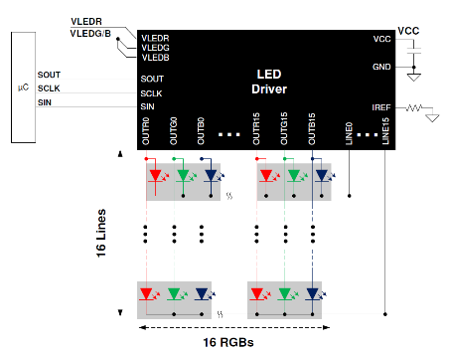
LP5891-Q1 Automotive 48x16 matrix LED driver with 16-bits PWM dimming and ultra low power
Features
Benefits
Separated VCC and VLED Power Supply
VCC Voltage Range: 2.5V – 5.5V ( Recommend: 2.5/2.8V)
VLEDR/G/B Voltage Range: 2.5V - 5.5V (R Recommend: 2.8V, B Recommend: 3.8V)
16 Integrated Line Scan Switches (NMOS)
R_{DS(ON)}: 190 mohm (typ)
48 Constant-Current-Source Channels from 0.1 mA to 20mA
Channel-to-channel, 0.5% (typ), 2% (max)
Device-to-device, 0.5% (typ), 2% (max)
Knee voltage: 0.3V @10mA(max)
3-Bit (8 steps) Global Brightness Control
8-Bit (256 steps) Color Brightness Control for each color group
Ultra Low Power Consumption
Icc=5.5mA (5.4uA/pixel) with Vcc=2.8V @ 50MHz
Intelligent Power Saving Mode (by channel)
Dynamic Power Saving Mode (by device) Icc down to 2.4mA
Active Power Saving Mode Icc down to 0.6mA
Maximum 16-Bit (65536 steps) PWM Grayscale Control
Built-in SRAM to support 48×16 LED Matrix With Single Device
High Speed 2-wire Communication Interface
External Serial Data Transfer Clock: 50MHz
Internal Clock Multiplier: 1× to 16x (up to 160MHz)
Common display issue solution
LED Open / Short Detection and Caterpillar Removal
Package: 9mmx9mm QFN-76
High accuracy constant current sources for enhanced uniformity
16-bit PWM resolution brings ultra smooth lighting effects
Low power consumption
Premium LED matrix performances
Applications
Automotive Interior Light
Automotive Rear Light
Automotive Local Dimming Backlight
LP5891-Q1
LP5891-Q1

Slide 28
Universal Plug-in Augmented Connectivity (UPAC) ‒ LP5899-Q1 SPI-Compatible Connectivity for LP5891-Q1
Features
Benefits
Input voltage range: 2.5V to 5.5V
Diagnostics
SPI CRC error detection
SPI time out detection
CCSI register data CRC detection
CCSI data input stuck-at detection
Oscillator fault detection
OTP CRC error detection
Fault pin report
Data ready interrupt
Operating ambient temperature (-40°C to 125°C)
Package:
WSON-12 Wettable (3mm*3mm*0.8mm)
SOT-14 (4.2mm*2mm*1.1mm)
Compatible with SPI controller
Reduced controller requirements with standard SPI interface and reduced CPU overhead
CCSI data integrity inspection
Applications
SPI compatible connectivity for LP5891-Q1

Slide 29
Illuminating LED driver roadmap
>30-V VIN max
<30-V VIN max
<18-V VIN max
Baikal
TPS92641 next gen
<7-V VIN max
Namtso
Buck
Namtso
Boost
100W
TPS922054
Inductive Fast Dimming
TPS922055
Inductive Fast Dimming
Spread Spectrum
TPS923654*
Inductive Fast Dimming
TPS923655*
Inductive Fast Dimming
Spread Spectrum
TPS92401
4-dot controller
Power Save Mode
TPS92402
8-dot controller
Power Save Mode
75W
TPS922052
Inductive Fast Dimming
TPS922053
Inductive Fast Dimming
Spread Spectrum
TPS923652*
Inductive Fast Dimming
TPS923653*
Inductive Fast Dimming
Spread Spectrum
Output Power
50W
TPS922050
Analog/PWM Dimming
TPS922051
Analog/PWM Dimming
TPS923650*
Analog/PWM Dimming
TPS923651*
Analog/PWM Dimming
20W
TPS92200
TPS61165
Vin max 18V
TPS923613
Vin_min 1.8V
10W
TPS92201
TPS61169
Vin_max 5.5V
TPS923610/1/2
Vout_max 30V
Buck
Boost
LED dot controller
* Boost / Buck-Boost multi-topology
Topology

Slide 30


TPS92205x / TPS92365x family
2A/4A non-synchronous multi-topo LED drivers with up to 65V input voltage, featuring high power density illumination and fast LED current rising/falling time
Kanas
TPS922052/3/4/5
TPS922050/1
TPS923652/3/4/5
TPS923650/1
Topology | Buck | Buck | Boost / Buck-Boost | Boost / Buck-Boost
Power density | Vin 4.5-65V, Iout 2A/4A | Vin 4.5-65V, Iout 1A/2A | Vin 4.5-65V, Iout 2A/4A | Vin 4.5-65V, Iout 1A/2A
SW frequency | 0.1~2.2MHz with S.S. | 1MHz / 0.4MHz | 0.1~2.2MHz with S.S. | 1MHz / 0.4MHz
Analog Dim. Ratio | 256: 1 | 200:1 | 256: 1 | 200:1
PWM Min. On time | 150ns | 50ns | 150ns | 50ns
Hybrid Dimming | Yes | No | Yes | No
Protection Mechanism | Fault output [open drain] | / | Fault output [open drain] | /
 | LED Open | LED Open | LED Open / Short | LED Open / Short
 | Thermal Foldback, OVP | Thermal Shutdown, OVP | Thermal Foldback, OVP | Thermal Shutdown, OVP
Package | VSON-14, WSON-12 SOT-14, | WSON-8, SOT-8, MSOP-8 | VSON-14, WSON-12 SOT-14 | WSON-8, SOT-8, MSOP-8

Slide 31
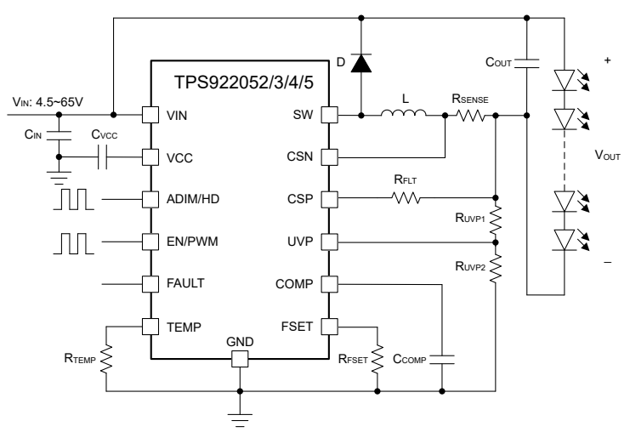
TPS922052/3/4/5 2/4-A Buck LED Driver with flexible & enhanced dimming performance
Features
Benefits
4.5V to 65V wide input range
LED common anode connection
Integrated 150mΩ MOSFET with typical 3A / 6A current limit
Optional switching frequency: 100kHz to 2.2MHz
Spread spectrum for TPS922053 and TPS922055
Advanced dimming options:
– Analog dimming (256:1)
– Fast PWM dimming (150ns pulse width)
– Hybrid and flexible dimming (2,000:1 at 20kHz PWM)
Full protection features:
– LED open and short protection
– Switching FET open and short protection
– External component failure protection
– Cycle-by-cycle current limit
– Thermal shutdown
– Fault output (open drain)
Configurable thermal foldback curve
VSON, WSON and SOT23 package options
High power density support various application
Fast response supports high contrast ratio
Multiple dimming methods enable high dimming performance
Buck Topology optimized pinout and layout for single layer PCB
Spread spectrum relaxes system EMI filter
Fault output for fast system fault handling
Thermal foldback brings more system reliability
Applications
Constant illumination:
– Indoor, outdoor, professional lighting
– Medical, surgical lighting
– Projector, laser TV, printer, IP camera
Instant illumination:
– Machine vision, camera flash
– Fire alarm, strobe
CC and CV source:
– LCD backlighting
– Battery charging
– TEC control
31

Slide 32
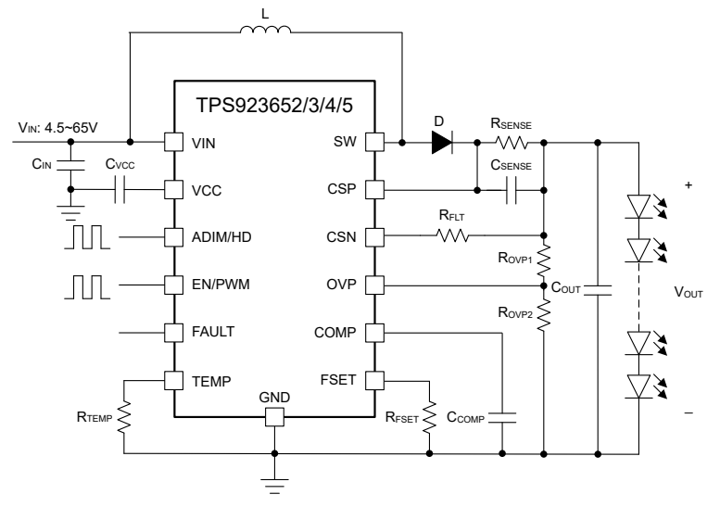
TPS923652/3/4/5 2/4-A Boost / Buck-Boost LED Driver with flexible & enhanced dimming performance
Features
Benefits
4.5V to 65V wide input range
LED common cathode connection
Integrated 150mΩ MOSFET with typical 3A / 6.5A / 8.5A current limit
Optional switching frequency: 100kHz to 2.2MHz
Spread spectrum for TPS923653 and TPS923655
Advanced dimming options:
– Analog dimming (256:1)
– Fast PWM dimming (150ns pulse width)
– Hybrid and flexible dimming (2,000:1 at 20kHz PWM)
Full protection features:
– LED open and short protection
– Switching FET open and short protection
– External component failure protection
– Cycle-by-cycle current limit
– Thermal shutdown
– Fault output (open drain)
Configurable thermal foldback curve
VSON, WSON and SOT23 package options
High power density support various application
Fast response supports high contrast ratio
Multiple dimming methods enable high dimming performance
Boost Topology optimized pinout and layout for single layer PCB
Spread spectrum relaxes system EMI filter
Fault output for fast system fault handling
Thermal foldback brings more system reliability
Applications
Constant illumination:
– Indoor, outdoor, professional lighting
– Medical, surgical lighting
– Projector, laser TV, printer, IP camera
Instant illumination:
– Machine vision, camera flash
– Fire alarm, strobe
CC and CV source:
– LCD backlighting
– Battery charging
– TEC control
32

Slide 33
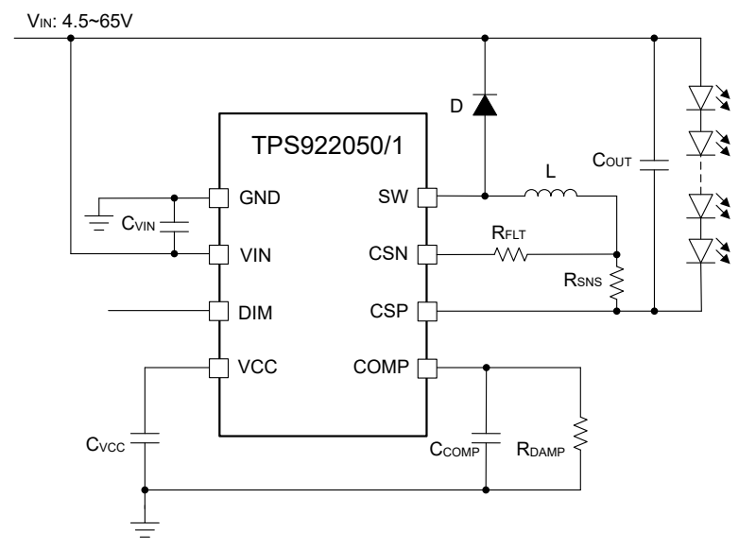
TPS922050/1 65-V 1-A/2-A Buck LED Driver with Analog/PWM Dimming
Features
Benefits
4.5V to 65V wide input range
LED common anode connection
Integrated 300mΩ MOSFET:
– Typical current limit (1.6A / 3.2A)
– Switching frequency (400kHz / 1MHz)
Advanced dimming options:
– Analog dimming (200:1)
– Fast PWM dimming (50ns pulse width)
Full protection features:
– LED open and short protection
– Switching FET open and short protection
– External component failure protection
– Cycle-by-cycle current limit
– Thermal shutdown
Package: WSON-8, HVSSOP-8, SOT583
High power density support various application
Short pulse response supports high dimming frequency and high contrast ratio
Buck Topology optimized low number pinout and layout for single layer PCB
Fault protection and thermal shutdown for essential reliability
Applications
Constant illumination:
– Indoor and outdoor lighting
– Appliance lighting
– Cold/warm WLED lighting
– Emergency and signage lighting
– Security floodlight
– LED bulb and lamp
– LCD backlight
Instant illumination:
– Machine vision and camera flash
– Fire alarm and strobe

Slide 34
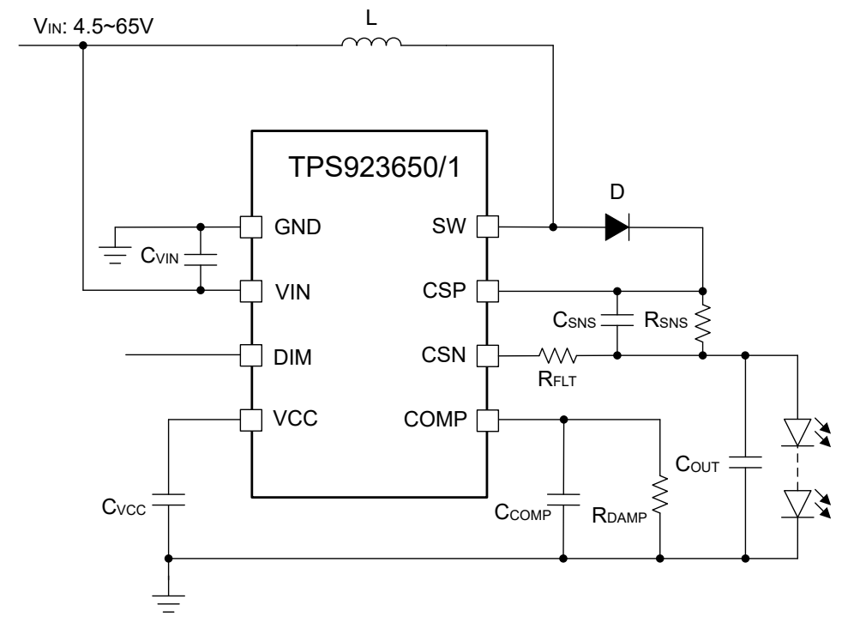
TPS923650/1 65-V 1-A/2-A Boost/Buck-Boost LED Driver with Analog/PWM Dimming
Features
Benefits
4.5V to 65V wide input range
LED common cathode connection
Integrated 300mΩ MOSFET:
– Typical current limit (1.6A / 3.2A)
– Switching frequency (400kHz / 1MHz)
Advanced dimming options:
– Analog dimming (200:1)
– Fast PWM dimming (50ns pulse width)
Full protection features:
– LED open and short protection
– Switching FET open and short protection
– External component failure protection
– Cycle-by-cycle current limit
– Thermal shutdown
Package: WSON-8, HVSSOP-8, SOT583
High power density support various application
Short pulse response supports high dimming frequency and high contrast ratio
Buck Topology optimized low number pinout and layout for single layer PCB
Fault protection and thermal shutdown for essential reliability
Applications
Constant illumination:
– Indoor and outdoor lighting
– Appliance lighting
– Cold/warm WLED lighting
– Emergency and signage lighting
– Security floodlight
– LED bulb and lamp
– LCD backlight
Instant illumination:
– Machine vision and camera flash
– Fire alarm and strobe

Slide 35
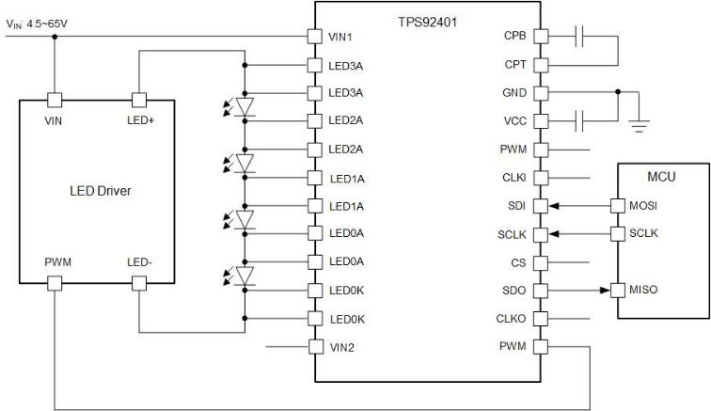
TPS92401 4-Channel 5-A LED Dot-Controller with Integrated FET and Advanced Dimming
Features
Benefits
Wide Input Voltage Range: 4.5V to 65V
Common Cathode / Common Anode
4 Integrated LED Bypass Switches
5A Max Continuous Current
Integrated 16-bit PWM Generator and SPI Interface
Programmable PWM Frequency Up to 60kHz
Programmable PWM Slew Rate and Shifting
Support SPI Daisy Chain / Star Connection
Protection & Diagnostics
Programmable LED Open Protection
LED Short / Resistive FET Detection
Thermal Warning
Support Power Save Mode
Support Stacked Configurations
Operating Ambient Temperature (-40°C to 125°C)
Package: VQFN-36
Extremely power efficient for ~5A LED pixel-level dot lighting control scenario
>20kHz PWM frequency support for no flickering in high speed camera and audible noise free
4-channel device for single-layer easy routing and flexible connection
Best compatible with TPS92205x and TPS92640/1 LED drivers
Applications
Stage Lighting
Surgical Lighting
Machine Vision Illumination
3D Printing
Atmosphere Lighting

Slide 36
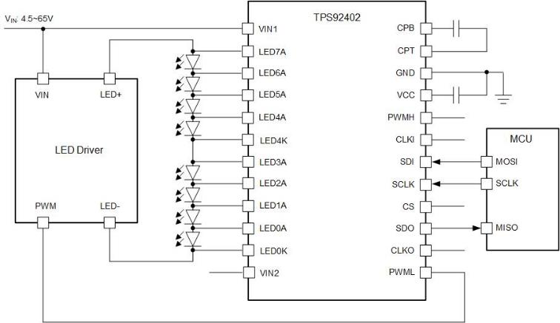
TPS92402 8-Channel 2.5-A LED Dot-Controller with Integrated FET and Advanced Dimming
Features
Benefits
Wide Input Voltage Range: 4.5V to 65V
Common Cathode / Common Anode
4 Integrated LED Bypass Switches
2.5A Max Continuous Current
Integrated 16-bit PWM Generator and SPI Interface
Programmable PWM Frequency Up to 60kHz
Programmable PWM Slew Rate and Shifting
Support SPI Daisy Chain / Star Connection
Protection & Diagnostics
Programmable LED Open Protection
LED Short / Resistive FET Detection
Thermal Warning
Support Power Save Mode
Support Stacked Configurations
Operating Ambient Temperature (-40°C to 125°C)
Package: VQFN-36
Extremely power efficient for ~2.5A LED pixel-level dot lighting control scenario
>20kHz PWM frequency support for no flickering in high speed camera and audible noise free
8-channel device for single-layer easy routing and flexible connection
Best compatible with TPS92205x and TPS92640/1 LED drivers
Applications
Stage Lighting
Surgical Lighting
Machine Vision Illumination
3D Printing
Atmosphere Lighting

Slide 37
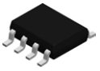
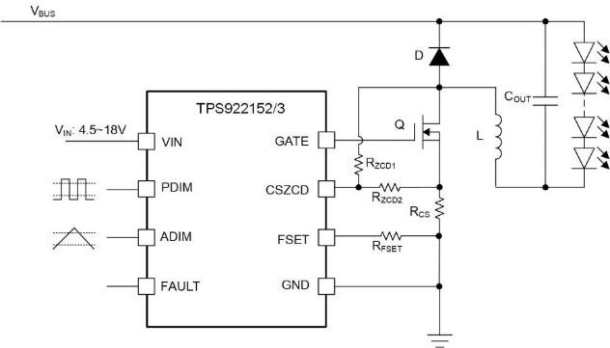
TPS922152/3/4/5 (Namtso) High Voltage Buck LED Driver with Accurate Dimming
Development
Features
Benefits
Supply Voltage Range: 4.5 to 18V
Common Anode
2-Ω, 1-A_{peak} MOSFET Gate Driver
Optional Control Mode:
Adaptive Off-Time (TPS922152)
Hysteresis Peak-Current (TPS922153)
ZCS Quasi-Resonant Transition (TPS922154)
ZVS True Quasi-Resonant (TPS922155)
Switching Frequency: 50kHz~2.2MHz
Mixed Dimming Option:
Analog Dimming (1000:1)
PWM Dimming (50ns pulse width)
Protection
LED Open / Short
Sense Resistor Open / Short
Cycle by Cycle Current Limit
Fault Output (Open Drain)
Operating Ambient Temperature(-40°C to 125°C)
Package: SOIC-8, SOT583
Supports wide dc bus voltage and LED string voltage up to >100V
Enables simple layout with low number of external components
Multiple control modes for variable system needs
Quasi-resonant switching allows high frequency and high efficiency
Accurate analog dimming enables high dimming ratio and accuracy
Fast PWM dimming enables high dimming frequency and high dimming ratio
Low output ripple eliminates flickering at low brightness
Compatible with GaN power stage, such as LMG362x
Applications
Industrial and Commercial Lighting
Indoor and Outdoor Lighting
Fire Alarm and Strobe
LCD TV/Display Backlight
LED Driver Module
LED Bulb/Lamp
37

Slide 38
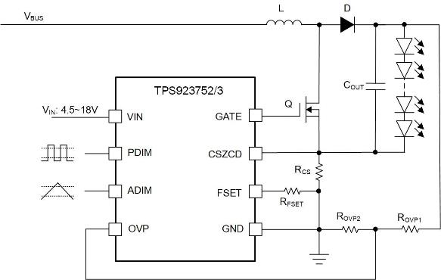
TPS923752/3/4/5 (Namtso) High Voltage Boost/SEPIC LED Driver with Accurate Dimming
Development
Features
Benefits
Supply Voltage Range: 4.5 to 18V
2-Ω, 1-A_{peak} MOSFET Gate Driver
Optional Operation Mode:
Adaptive Off-Time Boost (TPS923752)
Adaptive Off-Time SEPIC (TPS923753)
ZCS Quasi-Resonant Transition (TPS923754)
ZVS True Quasi-Resonant (TPS923755)
Switching Frequency: 50kHz~2.2MHz
Mixed Dimming Option:
Analog Dimming (1000:1)
PWM Dimming (50ns pulse width)
Protection
LED Open / Short
Sense Resistor Open / Short
Cycle by Cycle Current Limit
Fault Output (Open Drain)
Operating Ambient Temperature(-40°C to 125°C)
Package: SOIC-8, SOT583
Supports wide dc bus voltage and LED string voltage up to >100V
Enables simple layout with low number of external components
Multiple control modes for variable system needs
Quasi-resonant switching allows high frequency and high efficiency
Accurate analog dimming enables high dimming ratio and accuracy
Fast PWM dimming enables high dimming frequency and high dimming ratio
Low output ripple eliminates flickering at low brightness
Compatible with GaN power stage, such as LMG362x
Applications
Industrial and Commercial Lighting
Indoor and Outdoor Lighting
Fire Alarm and Strobe
LCD TV/Display Backlight
LED Driver Module
LED Bulb/Lamp
38

Slide 39
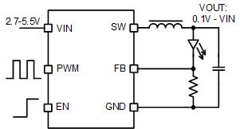
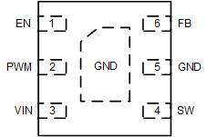
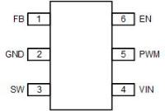
1-/1.5-A High Efficiency Synchronous Buck LED Driver
TPS92201(A)
Features
Benefits
Input Voltage Range: 2.5V to 5.5V
0.1-V to V_{IN} output voltage range
Up to 1-/1.5-A continuous output current
Integrated 200/160-mOhm HS/LS FET
Current Limit: 1.5-/2-A
1.5-MHz switching Frequency
100% mode operation
Analog Dimming with 1%-100% range
A-version: Power save mode for light load efficiency
Protection
Cycle by cycle current limit
LED Open / Short
Thermal Shutdown
Operating Ambient Temperature(-40°C to 85°C)
Package: SOT563, WSON
High efficiency for battery application
Both analog dimming supported to maximize dimming performance
Applications
Video Doorbell
IP network camera flash / illumination
Battery-powered device flash / illumination
General Illumination

Slide 40
TPS92200 4-30V/1.5-A Synchronous Buck LED Driver with Flexible Dimming Options
Features
Benefits
4V to 30V Wide Input Range
Integrated 150mΩ/90mΩ MOSFETs for 1.5A Continuous Output Current
1MHz Switching Frequency
Ultra-Low Shutdown Current: 1-μA
Ultra-Low Output Discharge Current from Load: 1-μA
Maximum Duty Cycle up to 99%
Flexible Dimming Options for different applications:
TPS92200D1: PWM Dimming with Digital Input and Analog Dimming with Analog Input
TPS92200D2: Analog Dimming with Digital Input
Ultra-low and Accurate FB Voltage: 100mV/+-3mV
Peak Current mode with Internal Compensation
Full Protections:
LED Open-Load Protection with Maximum Duty ON
LED+ Short to GND
LED+ / LED- Short Circuitry
Sense Resistor Open/ Short Protection
Thermal Shutdown
SOT23-6 (2.8 x 2.9 mm), VQFN-HR-6 (1.5 x 2 mm)
Ultra-low FB voltage for higher Efficiency
Ultra-low Shutdown Current (<1uA)
Flexible Dimming Options for Various Applications
Ultra-low Output Discharge Current help to Save An Output Diode for Charger Application
Small and Few external component count to optimize board space and cost
Applications
Device | Dimming Type | Dimming Input Type
TPS92200D1 | PWM Dimming | Digital Signal (frequency: 100Hz – 2kHz)
 | Analog Dimming | Analog Voltage (amplitude: 0.65-1.2V)
TPS92200D2 | Analog Dimming | Digital Signal (frequency: 20kHz – 200kHz)
Video Surveillance IR LED Driver
Facial Recognition IR LED Driver
Stage Lighting LED Driver
General Industrial and Commercial Illumiantion
AA or Li-ion Battery Charger
40

Slide 41
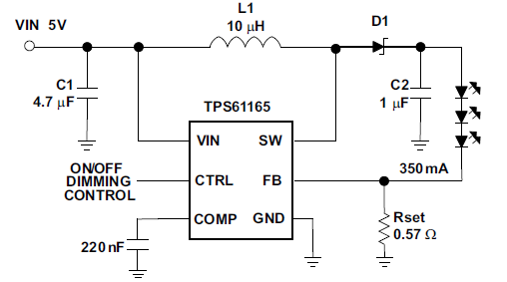
TPS61165 High Brightness White LED Driver in 2mm x 2mm WSON package
Features
Benefits
Wide Input Voltage Range: 3 -18V
38-V Open LED Protection
Up to 90% Efficiency
200-mV Reference Voltage With 2% Accuracy
Down to 1% Dimming Brightness
1.2-A Switch FET With 1.2-MHz Switching Frequency
One-Wire Control Interface (EasyScale™)
2.0 mm*2.0 mm WSON-6 Package with Thermal Pad and SOT-23 Package
Works with different power sources ( Industrial Rail, Li-ion Battery)
Smooth Brightness Transition
1% dimming ration can covers day/night ambient brightness conditions
High Efficiency help to increase battery endurance time
Small package for compact solutions and industrial applications
Applications
Smart Phones
Tablets and Gaming Tablets
Home Automation Panels
Home Appliance User Interface
Portable/ Small Media Form Factor Displays
EPOS
Handheld Medical Equipment
Thermostat Display
Blood Glucose Meters
Video Surveillance Camera
41

Slide 42
TPS923610/1/2 (NEMO)
Sample now
Single-channel Synchronous Boost LED Driver
Features
Benefits
Supply Voltage Range: 2.5V-5.5V
High efficiency Synchronous Boost with 280mΩ LSFET/600mΩ HSFET
High Precision PWM-to-analog Dimming Resolution up to 1000:1
1.8/2.3A Switch Current Limit
24.5V/30V Max Output Voltage
400k/1.2MHz Switching Frequency to with Small Size Inductor
Compatible with 1.2V I/O
Internal Bootstrap Capacitor
Internal Compensation
OVP/OCP/FB short-to-GND Protection
Package:
1.6mm*1.6mm SOT563-6
2mm*2mm WSON-6
Save Schottky diode for smaller solution size and lower BOM cost
Small chip / cap / inductor size for mobile applications
Unique PWM dimming function allows higher brightness dynamic range without additional cost
Applications
LCD backlighting
Smartphone and tablet
Handheld data terminals (EPOS)
Thermostat display
PDA, handheld computer and GPS receiver
Portable media player, portable TV and eBook
General illumination
IP camera
Flashlight

Slide 43

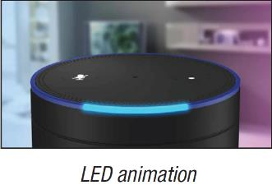
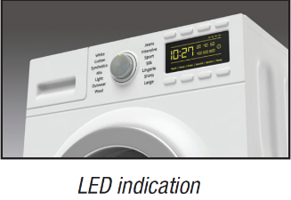
RGB LED Driver
Vout
5.5V
5.5V
5.5V
17V
LED dot/channel
1 to 12 LED dots
9 to 36 LED dots
18 to 198 LED dots
8 / 16 LED channels
Dimming
8-bit PWM
8-bit Analog
12-bit PWM
16-bit PWM
8-bit Analog
16-bit PWM
Interface
1-MHz I²C
400-kHz I²C
1-MHz I²C
12-MHz SPI
1-MHz I²C
Function
Auto animation
Boost
Group control
Group control
Stackable
Package
WCSP
DFN
QFN
TSSOP
QFN
TSSOP
QFN
TSSOP
LP581x
LP50xx
LP586x (T)
TLC59116
LP5817 / 6 / 5 / 4 / 3 / 2 / 1 / 0
LP5036 / 30 / 24 / 18 / 12 / 09
LP5860T / 8T / 7 / 6T / 4 / 2 / 1T
TLC59108 / 16

Slide 44
RGB LED Driver Roadmap
In development/definition
New release
Released
71-400 LEDs
LP5864
18x4 matrix
LP5866/8/0 (T)
18x6/8/11 matrix
T-version: 100mA/ch
LP5867
7x6 matrix
WCSP package
Tetris
18x13 matrix
Tetris Plus
33x13 matrix
13-70 LEDs
TLC59116
16 channel
VLED_max 17V
LP5018/24/30/36
18 -36 channel
LP5861 (T)
18 channel
T-version: 120mA/ch
LP5862
18x2 matrix
Moomin
48 channel
LP55281
12 channel
Integrated sync. boost
LP5569
9 channel w/ charge pump
LP5813
4x3 matrix
Integrated sync. boost
5-12 LEDs
LP5812
4x3 matrix
LP5009/12
9/12 channel
LP5521
3 channel w/ charge pump
LP5811
4 channel
Integrated sync. boost
1-4 LEDs
LP5562
4 channel
LP5810
4 channel
Auto Animation
LP5814/5
4/3 channel
Auto Animation, InstaBlink
LP5816/7
4/3 channel
Number of LEDs
Notes:
Mark spread spectrum
RGB & ILLM one-page guild

Slide 45
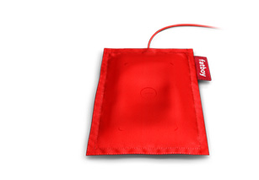
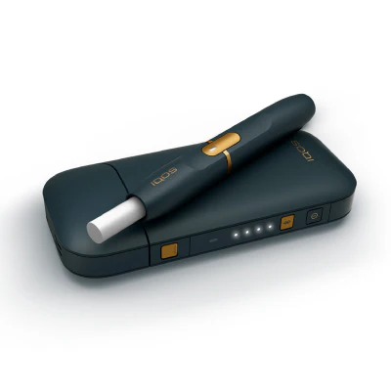
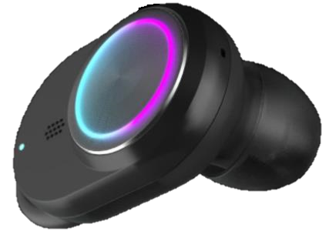

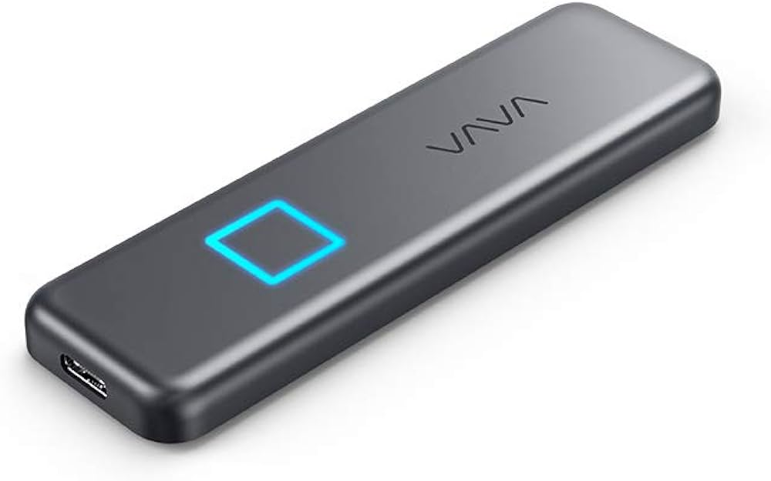
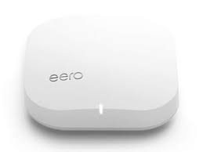

LP581x Family Introduction
RGB LED driver family for up to 12 LED dots optional equipped with sync boost, auto animation control, and charging indication
LP581x value propositions
Maximized battery life ─ down to 500uA operation current, 94% efficiency sync. boost
Optimize solution cost and size ─ Time-cross-multiplexing (TCM) matrix architecture
Free MCU real-time bus load ─ auto animation control with register configuration
InstaBlink™ Indication ─ Instant LED blinking via STAT pin control
LP581x
Linear
1.6A Sync Boost
Linear
1.6A Sync Boost
Linear
Linear
Linear
Linear
4 LEDs
4 LEDs
4x3 = 12 LEDs
4x3 = 12 LEDs
4 LEDs
3 LEDs
4 LEDs
3 LEDs
Auto Animation
Auto Animation
Auto Animation
Auto Animation
Auto Animation
Auto Animation
LOD / LSD
External SYNC
LOD / LSD
External SYNC
LOD / LSD
External SYNC
LOD / LSD
External SYNC
InstaBlink
InstaBlink
LP5810
DSBGA-9 (1.4 x 1.4mm)
WSON-8 (3 x 3mm)
LP5811
DSBGA-12 (1.8 x 1.4mm)
WSON-12 (3 x 3mm)
LP5812
DSBGA-9 (1.4 x 1.4mm)
WSON-8 (3 x 3mm)
LP5813
DSBGA-12 (1.8 x 1.4mm)
WSON-12 (3 x 3mm)
LP5814/I
DSBGA-8 (1.4 x 0.8mm)
SOT-8 (1.6 x 2.1mm)
LP5815
DSBGA-8 (1.4 x 0.8mm)
SOT-8 (1.6 x 2.1mm)
LP5816
DSBGA-8 (1.4 x 0.8mm)
SOT-8 (1.6 x 2.1mm)
LP5817
DSBGA-8 (1.4 x 0.8mm)
SOT-8 (1.6 x 2.1mm)

Slide 46
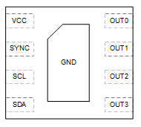
LP5810/2
RTM
4/12 LED Dots I²C RGB LED Driver With Auto Animation Control
Features
Benefits
Supply voltage range: 2.7V – 5.5V
Time-cross-multiplexing (TCM) dot matrix
Up to 12 LEDs (4 RGB LEDs) with individual control
Current source/sink capability: 50mA when Vcc > 3.3V
Average LED current: 4-dot: 50mA(Max.), 12-dot: 12.5mA(Max.)
6kHz multiplexing frequency to avoid visual flicker
Ultra-low power consumption
Standby current: 2uA(Typ.), 4uA(Max.)
Operation current in normal mode: 0.5mA(Typ.)
Flexible dimming control
PWM dimming: 8-Bit, Gamma correction: 256 steps, 24kHz Freq.
Analog dimming: 8-Bit
1MHz I²C interface, 4 P/N to support up to 4 devices used with one I²C bus
Logic pin power rail: 1.8V / 3.3V / 5V
Autonomous control: Auto breathing and blinking
LED open/short detection
Operating temperature range: -40°C ~ +85°C
Package: DSBGA-9 (1.43mm x 1.43mm), WSON-8 (3mm x 3mm)
Low supply voltage and Boost enable battery-powered applications (AA battery, Coin cell, Li-ion)
Time-cross-multiplexing(TCM) scheme saves total system PCB size and PCB traces
Ultra-low Iq saves system power and extends battery life
Flexible dimming control for smooth LED lighting patterns
Autonomous control offloads MCU bandwidth
2.7V
-
Applications
5.5V
VCC
OUT
0
1uF
D1
Battery powered applications: E-tag, Smart watch, E-Cigarettes, Wearables
Smart speaker
Router and switches
Internet-of-Things (IOT)
Handheld device
OFF
ON
LP5812
OUT1
SCL
D2
SDA
OUT2
SYNC/INT
D3
D4
GND
OUT3

Slide 47
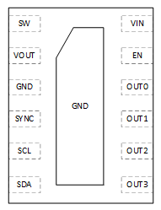
LP5811/3
RTM
4/12 LED Dots I²C Synchronous Boost RGB LED Driver With Auto Animation Control
Features
Benefits
Supply voltage range: 0.5V – 5.5V (Powering up from 1.8V)
Vout up to 5.5V for Boost
Time-cross-multiplexing (TCM) dot matrix
Up to 12 LEDs (4 RGB LEDs) with individual control
Current source/sink capability: 50mA when Vcc > 3.3V
Average LED current: 4-dot: 50mA(Max.), 12-dot: 12.5mA(Max.)
6kHz multiplexing frequency to avoid visual flicker
Ultra-low power consumption
Shutdown current: 0.2uA(Typ.), 2uA(Max.)
Standby current: 3uA(Typ.), 5uA(Max.)
Operation current in normal mode: 0.5mA(Typ.)
Flexible dimming control
PWM dimming: 8-Bit, Gamma correction: 256 steps, 24kHz Freq.
Analog dimming: 8-Bit
1MHz I²C interface, 4 P/N to support up to 4 devices used with one I²C bus
Logic pin power rail: 1.8V / 3.3V / 5V
Autonomous control: Auto breathing and blinking
LED open/short detection
Operating temperature range: -40°C ~ +85°C
Package: DSBGA-12 (1.84mm x 1,43mm), WSON-12 (3mm x 3mm)
Low supply voltage and Boost enable battery-powered applications (AA battery, Coin cell, Li-ion)
Time-cross-multiplexing(TCM) scheme saves total system PCB size and PCB traces
Ultra-low Iq saves system power and extends battery life
Flexible dimming control for smooth LED lighting patterns
Autonomous control offloads MCU bandwidth
Applications
Battery powered applications: E-tag, Smart watch, E-Cigarettes, Wearables
Smart speaker
Router and switches
Internet-of-Things (IOT)
Handheld device
47

Slide 48
LP5814 4 - CH RGBW LED driver with auto animation
Features
Benefits
Supply Voltage Range: 2.5V-5.5V
VLED up to 5.5V
4-CH RGBW LED driver
Current sink capability: max 51mA
Ultra-low power consumption
Shutdown current: 0.1uA(Typ.), 0.3uA(Max.)
Standby current: 26uA(Max.)
Dimming control
Individual PWM dimming: 23kHz, 8-bit
Individual analog dimming: 8-bit
1MHz/400kHz I2C interface
Autonomous animation control
Compatible with 1.8V I/O
ESD: 4kV HBM, 1.5kV CDM
Package: 1.6mm*2.1mm SOT583, 1.36mm*0.8mm WCSP-8 with 0.35mm pitch
Ultra-low Iq saves system power and extends battery life
Autonomous control offloads MCU bandwidth
>20KHz dimming frequency to eliminate audible noise
3V~5.5V
LP5814
Applications
RGB Indicator
E-cigarette
Router and Access point
Smart Home Appliance
TWS/Earbuds

Slide 49
LP5815 3 - CH RGB LED driver with auto animation and controllable InstaBlink
Features
Benefits
Supply Voltage Range: 2.5V-5.5V
VLED up to 5.5V
3 - CH RGB LED driver
Controllable InstaBlink
Current sink capability: max 51mA
Ultra-low power consumption
Shutdown current: 0.1uA(Typ.), 0.3uA(Max.)
Standby current: 26uA(Max.)
Dimming control
Individual PWM dimming: 23kHz, 8-bit
Individual analog dimming: 8-bit
1MHz/400kHz I2C interface
Autonomous animation control
Compatible with 1.8V I/O
ESD: 4kV HBM, 1.5kV CDM
Package: 1.6mm*2.1mm SOT583, 1.36mm*0.8mm WCSP-8 with 0.35mm pitch
Instant blinking via STAT pin control
Ultra-low Iq saves system power and extends battery life
Autonomous control offloads MCU bandwidth
>20KHz dimming frequency to eliminate audible noise
3V~5.5V
LP5815
Applications
RGB Indicator
E-cigarette
Router and Access point
Smart Home Appliance
TWS/Earbuds
Notes:
InstaBlink – instant blinking

Slide 50
LP5816 4 - CH RGBW LED driver
Features
Benefits
Supply Voltage Range: 2.5V-5.5V
VLED up to 5.5V
4-CH RGBW LED driver
Current sink capability: max 51mA
Ultra-low power consumption
Shutdown current: 0.1uA(Typ.), 0.3uA(Max.)
Standby current: 26uA(Max.)
Dimming control
Individual PWM dimming: 23kHz, 8-bit
Individual analog dimming: 8-bit
1MHz/400kHz I2C interface
Automatically fade in and fade out
Compatible with 1.8V I/O
ESD: 4kV HBM, 1.5kV CDM
Package: 1.6mm*2.1mm SOT583, 1.36mm*0.8mm WCSP-8 with 0.35mm pitch
Ultra-low Iq saves system power and extends battery life
>20KHz dimming frequency to eliminate audible noise
3V~5.5V
LP5816
Applications
RGB Indicator
E-cigarette
Router and Access point
Smart Home Appliance
TWS/Earbuds

Slide 51
LP5817 3 - CH RGB LED driver
Features
Benefits
Supply Voltage Range: 2.5V-5.5V
VLED up to 5.5V
3 - CH RGB LED driver
Current sink capability: max 51mA
Ultra-low power consumption
Shutdown current: 0.1uA(Typ.), 0.3uA(Max.)
Standby current: 26uA(Max.)
Dimming control
Individual PWM dimming: 23kHz, 8-bit
Individual analog dimming: 8-bit
1MHz/400kHz I2C interface
Automatically fade in and fade out
Compatible with 1.8V I/O
ESD: 4kV HBM, 1.5kV CDM
Package: 1.6mm*2.1mm SOT583, 1.36mm*0.8mm WCSP-8 with 0.35mm pitch
Ultra-low Iq saves system power and extends battery life
>20KHz dimming frequency to eliminate audible noise
3V~5.5V
LP5817
Applications
RGB Indicator
E-cigarette
Router and Access point
Smart Home Appliance
TWS/Earbuds

Slide 52


LP586x(T) Family Introduction
11 × 18 LED (T: high-current) LED matrix driver with 8-bit analog and 8-/16-bit PWM dimming
Benefits for matrix LED Application
Premium visual effect: 8 bits analog dimming and 8/16 bits PWM dimming
Flexible interface options: I2C (1-MHz) and SPI (12-MHz)
Solution cost and size: Time-multiplexing architecture and integrated de-ghosting
High refresh rate: auto-increment function and individual LED dot register
SPI&I2C Interface
11 x 18 Matrix
SPI&I2C Interface
8 x 18 Matrix
SPI&I2C Interface
6 x 18 Matrix
SPI&I2C Interface
4 x 18 Matrix
SPI&I2C Interface
2 x 18 Matrix
SPI&I2C Interface
1 x 18 Multi-ch
8-bit DC
16-bit PWM dim
8-bit DC
16-bit PWM dim
8-bit DC
16-bit PWM dim
8-bit DC
16-bit PWM dim
8-bit DC
16-bit PWM dim
8-bit DC
16-bit PWM dim
T for > 100mA/ch
T for > 100mA/ch
T for > 100mA/ch
T for > 100mA/ch
SRAM
LOD/
LSD
SRAM
LOD/
LSD
SRAM
LOD/
LSD
SRAM
LOD/
LSD
SRAM
LOD/
LSD
SRAM
LOD/
LSD
LP5860 (T)
5mm x 5mm QFN-40
LP5868 (T)
5mm x 5mm QFN-40
LP5866 (T)
5mm x 5mm QFN-40
9.7mm x 4.4mm TSSOP
LP5864
4mm x 4mm QFN-32
LP5862
4mm x 4mm QFN-32
9.7mm x 4.4mm TSSOP
LP5861 (T)
4mm x 4mm QFN-32

Slide 53
LP586x(T)
Nx18 LED Matrix Driver with 8-bit Analog and 8-/16-bit PWM Dimming
Features
Package:
QFN-32, 4x4mm(0.4mm pitch) --- LP5861(T), LP5862, LP5864
QFN-40, 5x5mm(0.4mm pitch) --- LP5866(T), LP5868(T), LP5860(T)
TSSOP-38, 9.7x4.4mm(0.5mm pitch) --- LP5866, LP5862
18 Constant Current Sink with N Switches:
LP5861(T): N=1: drive 18 LED dots or 6 RGB pixels.
LP5862: N=2: drive 36 LED dots or 12 RGB pixels.
LP5864: N=4: drive 72 LED dots or 24 RGB pixels.
LP5866(T): N=6: drive 108 LED dots or 36 RGB pixels.
LP5868(T): N=8: drive 144 LED dots or 48 RGB pixels.
LP5860(T): N=11: drive 198 LED dots or 66 RGB pixels.
Operating Voltage Range: VCC/VLED Range: 2.7V to 5.5V; VIO Range: 1.8V to 5V power rails
Constant Current Sinks with High Precision:
0.1-50 mA Maximum per current sink when VCC ≥ 3.3V
0.1-100 mA Maximum per current sink for T versions only when VCC ≥ 3.3V
Device-to-Device Error: ±5%; Channel-to-Channel Error: ±5%;
Flexible Dimming Options:
Individual ON/OFF Control for Each Channel
Analog Current Gain Control
Global 3-bits Maximum Current(MC) Setting without Ext. Resistor
3 Groups of 7-bits Color Current(CC) Setting
Individual 8-bits Dot Current(DC) Setting
Audible Noise Free (>20KHz) PWM Control
Global 8-bits PWM for Global Dimming
3 Programmable Groups of 8-bits PWM Dimming
Individual 8-bits/16bits PWM for Each LED Dot
Full Addressable SRAM for Minimum Data Volume
Ultra low quiescent current
Shutdown Mode: 2uA (max.) when EN Low.
Standby Mode: 10uA (max.) when CHIP_EN Low (data retained).
Optional Interface: Up to 1MHz I2C, Up to 12MHz SPI.
LED open/short detection
De-ghost, caterpillar removal, Low-brightness Compensation, low LED reverse voltage
Benefits
High integration: (18xN) matrix structure up to 198 LEDs
Highest dimming resolution: 16 bits (>20KHz) PWM dimming, 8 bits individual analog dimming
Ease of design: ‘True programmable group control’, ‘Minimum uC’s loadings’ and ‘Free of Matrix issues’
Applications
LED animation and indication for:
Keyboard, mouse, and gaming accessories
Major and smart home appliances
Smart speaker, wired and wireless speaker
Audio mixer, DJ equipment, and broadcast
Access equipment, switches, and servers
Constant current sinks for optical module

Slide 54
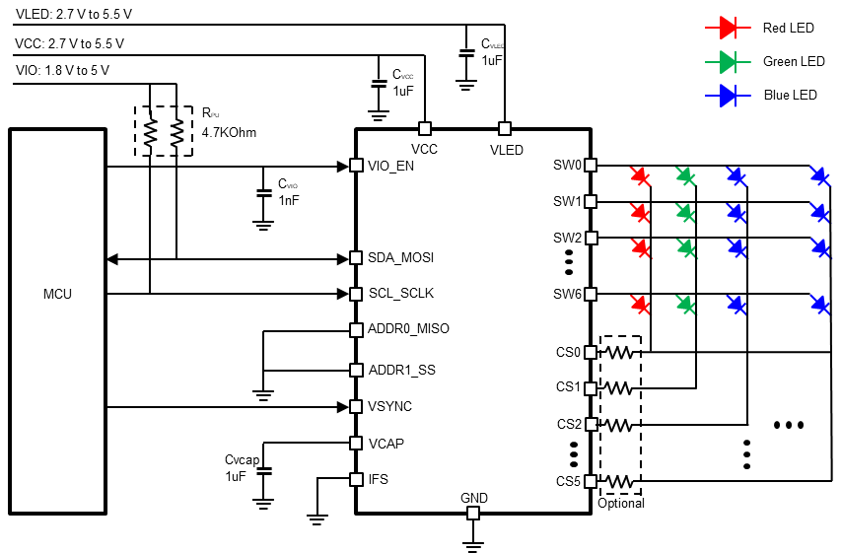
LP5867WCSP 7×6 Matrix LED Driver
Features
Benefits
12 Constant Current Sink with N Switches
LP5861: N=1: drive 6 LEDs
LP5862: N=2: drive 12 LEDs
LP5864: N=4: drive 36 LEDs
LP5867: N=7: drive 42 LEDs
Operating Voltage Range:
VCC/VLED Range: 2.7V to 5.5V
VIO Range: 1.8V to 5V power rails
Constant Current Sinks with High Precision:
1-50 mA Maximum per Channel when VCC ≥ 3.3V
Device-to-Device Error: ±5%; Channel-to-Channel Error: ±5%;
Flexible Dimming Options:
Individual ON/OFF Control for Each Channel
Analog Current Gain Control
3-bits Maximum Current Setting without Ext. Resistor
3x7-bits Current Setting for Each Color Group
8-bits Individual Current Setting for Each Channel
Audible Noise Free (>20KHz) PWM Control (125KHz/62.5KHz)
8-bits Master PWM for Global Brightness Control
3x8-bits Bank PWM for Programmable Group Control
8-bits/16bits Individual PWM for Each Channel
Full Addressable SRAM for Minimum Data Volume
Ultra low quiescent current
Shutdown Mode:
1uA (max.) when EN Low.
10uA (max.) when CHIP_EN Low (data retained).
Optional Interface: Up to 1MHz I2C, Up to 12MHz SPI.
LED open/short detection
Deghosting, caterpillar removal, Low-brightness Compensation, low LED reverse voltage
Package:
WCSP-24, 2.5x1.8mm(0.4mm pitch), Ball Diameter 180um
Small package: 2.5x1.75mm (0.4mm pitch)
Two PCB layer supported
High integration: (7xN) matrix structure up to 42 LEDs for single chip.
Highest dimming resolution: with up to 16 bits (>20KHz) PWM dimming, 8 bits per channel analog dimming
Easy of Design: with ‘Programmable group dimming’ function and ‘Minimum data volume’ design

Slide 55
LP50xx
36/30/24/18/12/9-Ch 12-Bit PWM Ultra-low Quiescent Current I2C RGB LED Drivers
Features
Benefits
Operating Voltage Range:
Vcc Range: 2.7V to 5.5V
EN, SDA and SCL pins compatible with 1.8V, 3.3V and 5V Power rails
Output Maximum Voltage: 6V
Constant Current Sinks with High Precision
25.5 mA Maximum per Channel when VCC in full range
35 mA Maximum per Channel when VCC ≥ 3.3V
Device-to-Device Error: ±5%; Channel-to-Channel Error: ±5%
Ultralow Quiescent Current
Shutdown Mode: 1uA (Max.) when EN = LOW
Power Saving Mode: 10uA (Typ.) when EN = HIGH & All LEDs Off > 30ms
Integrated 12 Bit, 29 kHz PWM Generator for each channel
Independent Color Mixing Register per channel
Independent Brightness Control Register per RGB LED Module
Optional Logarithmic- or Linear-Scale Brightness Control
Integrated 3-Phase-Shifting PWM Scheme
3 Programmable Banks (R/G/B) for Easy Software Control of each Color
Two External Hardware Address Pins for Connection up to 4 Devices
Broadcast Slave Address for Configuring Multiple Devices Simultaneously
Auto-Increment Writing or Reading Consecutive Registers within one Transmission
Up to 400K Hz Fast-Mode I2C Speed
Easy and Optimized Design for Color Mixing and Brightness Smooth Control with high resolution PWM generators in each channel
29KHz internal PWM Generators offer enough margin to eliminate the audible noise
Easy Software Control of Each Color and Good Channels Synchronization with 3 programmable banks
Balance System Level Power Consumption without Side Effect for LED Animation by ultralow quiescent current in Power Save Mode
Minimize the Input Power Budget with 3 phases PWM shifting
Applications
Smart Speaker, Smart Home Appliance
Doorbell, Electric Lock
Smoke Detector, Thermostat
Set-Top Box, Smart Router
Bluetooth® Headset, Handheld Device

Slide 56
LP5036-Q1 36-Ch I2C RGB LED Driver
Features
Benefits
Operating Voltage Range:
Vcc Range: 2.7V to 5.5V
EN, SDA and SCL pins compatible with 1.8V, 3.3V and 5V Power rails
Output Maximum Voltage: 6V
Constant Current Sinks with High Precision
25.5 mA Maximum per Channel when VCC in full range.
35 mA Maximum per Channel when VCC ≥ 3.3V.
Device-to-Device Error: ±5%; Channel-to-Channel Error: ±5%
Ultralow Quiescent Current
Shutdown Mode: 1uA (Max.) when EN = LOW
Power Saving Mode: 10uA (Typ.) when EN = HIGH & All LEDs Off > 30ms
Integrated 12 Bit, 29 kHz PWM Generator for each channel
Independent Color Mixing Register per channel
Independent Brightness Control Register per RGB LED Module
Optional Logarithmic- or Linear-Scale Brightness Control
Integrated 3-Phase-Shifting PWM Scheme
3 Programmable Banks (R/G/B) for Easy Software Control of each Color
Two External Hardware Address Pins for Connection up to 4 Devices
Broadcast Slave Address for Configuring Multiple Devices Simultaneously
Auto-Increment Writing or Reading Consecutive Registers within one Transmission
Up to 400K Hz Fast-Mode I2C Speed
Easy and Optimized Design for Color Mixing and Brightness Smooth Control with high resolution PWM generators in each channel
26KHz internal PWM Generators offer enough margin to eliminate the audible noise
Easy Software Control of Each Color and Good Channels Synchronization with 3 programmable banks
Balance System Level Power Consumption without Side Effect for LED Animation by ultralow quiescent current in Power Save Mode
Minimize the Input Power Budget with 3 phases PWM shifting
Applications
Smart Speaker, Smart Home Appliance
Doorbell, Electric Lock
Smoke Detector, Thermostat
Set-Top Box, Smart Router
Bluetooth® Headset, Handheld Device
56

Slide 57
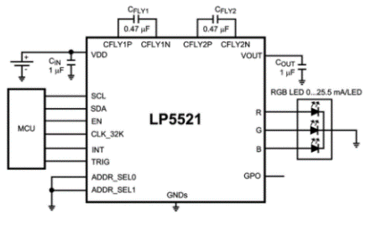
LP5521
3-Channel RGB, White-LED Driver With Internal Program Memory and Integrated Charge Pump
Features
Benefits
Adaptive charge pump with 1x and 1.5x gain provides up to 95% LED drive efficiency
200 nA typical shutdown current
Independently programmable constant current outputs with 8-bit current setting and 8-bit PWM control
Three program execution engines with flexible instruction set
Package: MicroSMD-20 package, 0.4 mm pitch
Inductorless high efficiency LED driver solution
Ultra low power consumption
Lighting engines allow autonomous pattern generation without processor
3 output supports 1x RGB LED for color lighting effects – Ability to generate wide range of colors
Small solution size
Applications
Blood Glucose Meter
Handheld POS Terminals
Electronic Access Control
Fun / Indicator lights
LCD sub-display backlighting
Keypad RGB backlighting
Where RGB Indication is needed

Slide 58
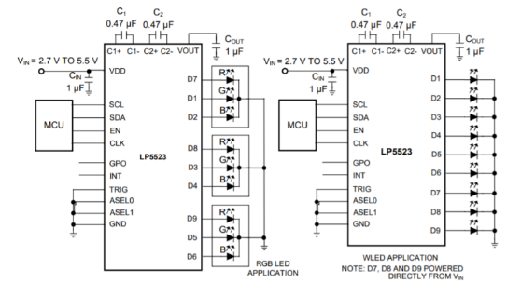
LP5523
9-Channel RGB-, White-LED Driver With Internal Program Memory and Integrated Charge Pump
Features
Benefits
Three independent engines
25.5mA full scale, 8 bit current resolution, 12 bit PWM control
Adaptive high efficiency charge pump
Internal program memory
Trigger input interface
20nA typical standby current
24 pin 2.3mm x 2.3mm DSBGA-26 package
Flexible control of LED lighting patterns
Lots of current control for LED lighting and/or color balancing
Full functionality over battery voltage range, down to 2.7V
No need for extra memory chip or microcontroller
Allows for GPIO triggering, rather than I2C write
Low system power impact when disabled
Applications
E-cigarette
Smart phones
Tablets
Performance Displays
Conference phones
LCD sub-display backlighting
Keypad RGB backlighting and phone cosmetics
Vibra, speakers, waveform generator

Slide 59
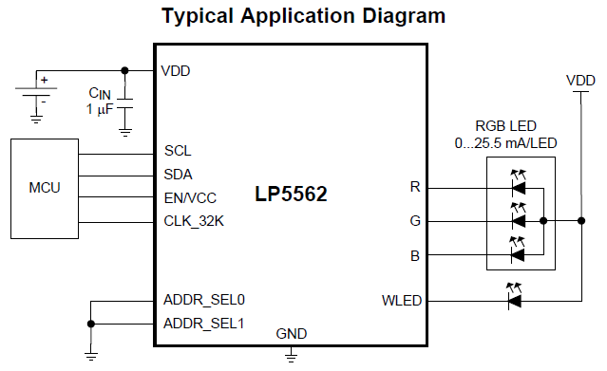
LP5562
4-Ch RGB-,White-LED Driver With Internal Program Memory and Independent Channel Control
Features
Benefits
RGB LED support with extra message indicator or 4 channel keyboard backlight support
Flexible lighting effects and run times for system efficiency savings and autonomous operation
Low power
System power savings when in shutdown or active
I2C Interface Common Anode LED Drivers
4 CHs Constant Current Range: 0 – 25.5mA
8-Bit Individual Dot Correction
8-Bit Individual PWM Dimming
Output Current Error: +-5%, Channel to Channel Error: +-2%
Autonomous Operation With Program Execution Engines
SRAM Memory for Sequences
LOOPs, RAMPs, TRIGGERs, INT
Ultra Low Power Operation
Standby supply current (EN = 0, CHIP_EN = 0): 200nA
Automatic Power-Save Mode With External Clock: 10uA
Package: DSBGA (12), 1.648 mm × 1.248 mm
Applications
Fun Lights
Indicator Lights
Keypad RGB Backlighting and Phone Cosmetics
Routers and Switches
Smart watches

Slide 60
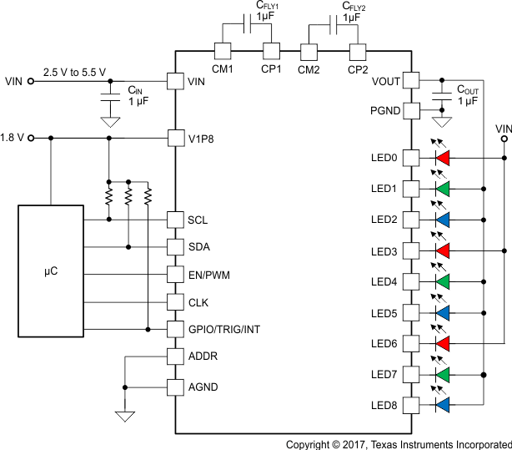
LP5569
9-Channel I2C RGB LED Driver With Engine Control and Charge Pump
Features
Benefits
Supply Voltage Range: 2.5-5.5V
9 High-Accuracy Current Sinks
25.5 mA Maximum per Channel
8-Bit Individual Current Control
12-Bit 20-kHz Internal Individual PWM Control Without Audio Noise
Three Programmable LED Engines
Independent Illumination Control Without Active Microcontroller Control
Synchronization Among Multiple Devices
Up to 256 Instructions in SRAM for Storing Lighting Patterns
LP5523- and LP55231-Device-Compatible Command Set
Flexible Dimming Control
I2C Dimming Control
Engine Dimming Control
PWM Direct Input Dimming (100-Hz to 20-kHz)
Adaptive Charge-Pump to Drive High-VF LEDs With Low Battery Voltage
Master Fader Control Allows Dimming of Multiple LEDs by Writing to Only One Register to Reduce the I2C Bus Traffic
2-μA Low Standby Current and 10-μA in Automatic Power-Save Mode When LEDs Are Inactive
Package: WQFN-24, 4.00 mm × 4.00 mm
Ultra smooth color changing and fading with high PWM resolution and dot correction
Autonomous operation reduces system power consumption when the processor in sleep mode
Easy coding for Flexible LED lighting Patterns
Full functionality over battery voltage range
Easy manufacturability with integrated diagnostic
Applications
Smart Speaker, Smart Home Appliance
Doorbell, Electric Lock
Smoke Detector, Thermostat
Set-Top Box, Smart Router
Bluetooth® Headset, Handheld Device
PART NUMBER | GROUP | I2C SLAVE ADDRESS
LP5569RTWR | 0 | 32h-35h and 40h (40h is broadcast address)
LP5569ARTWR | 1 | 42h-45h and 40h (40h is broadcast address)
60

Slide 61
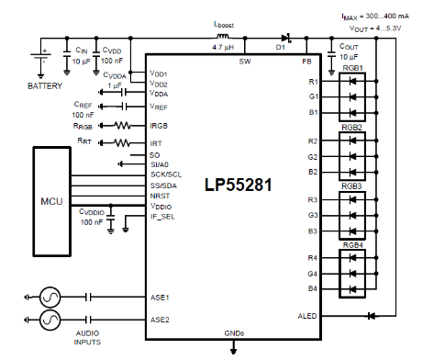
LP55281
12-Channel RGB/White-LED Drive With Boost
Features
Benefits
Audio synchronization for a single fun light LED
4 PWM controlled RGB LED drivers
High efficiency Boost DC-DC converter
SPI/I2C compatible interface
2 addresses in I2C compatible interface
LED connectivity test through the serial interface
Small 36-bump Micro SMD (3 mm x 3 mm x 0.6 mm) or 36-bump Micro SMDxt package (3 mm x 3 mm x 0.65 mm)
Integrated boost LED drive solution
Ultra low power consumption
Small solution size
Applications
Cellular Phones
PDAs, MP3 players
Electronic smart locks
E-cigarettes

Slide 62

TLC59108 / 116
8-CH/16-CH I2C Bus Constant-Current LED Drivers
Features
Benefits
8/16 CHs Constant Current Range: 5mA to 120mA
Input Voltage Range: 3V to 5.5V
Maximum Output Voltage: 17V
Output Current Error: +-8%, Channel to Channel Error: +-6%
Global brightness control and Adjusted Through an External Resistor
Individual / Global 8 bits PWM Dimming
256-Step Individual Dimming with 97KHz PWM Signal
256-Step Group Dimming with 190Hz PWM Signal
256-Step Group Blinking with Programmable Frequency
LED Open and Over temperature Detection
4 Hardware Address Pins Allow 14 Devices
1MHz Fast-Mode Plus / 400KHz Fast-Mode / 100KHz Standard I2C Speed
25-MHz Internal Oscillator Requires No External Components
Packages: TSSOP VQFN
TLC59108: TSSOP-20, VQFN-20
TLC59116: TSSOP-28, VQFN-32
Flexible LED connection
High current capacity
FM+ Transfer Rate Support
Accurate constant current driving
Comfortable user control
Applications
Gaming
Small Signage
Industrial Equipment

